Slide 1
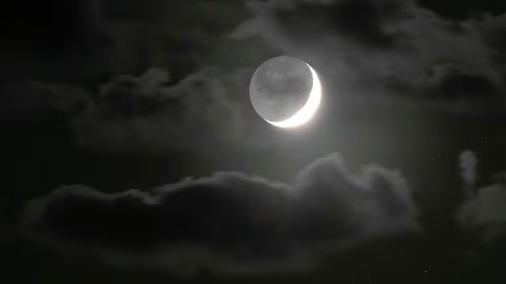

Slide 2
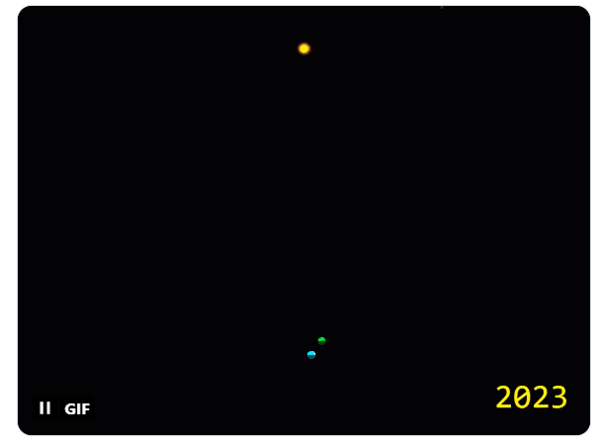
Why In The News?
Astronomers Have Discovered A "Quasi-Moon” - An Asteroid That Orbits The Earth But Is Gravitationally Bound By The Sun. It Is Called 2023 FW13 And Was Spotted Recently, Causing A Stir Among Space Enthusiasts.

Slide 3
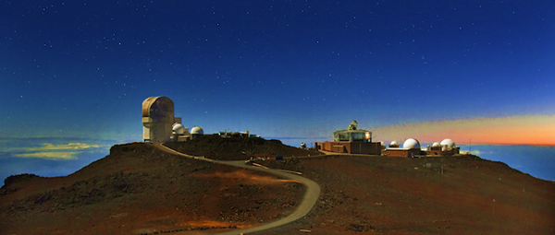
Why In The News?
Experts Used The Pan Starrs Telescope At The Top Of The Haleakala Volcano In Hawaii To Observe The Space Rock Which Has Been Labelled A Quasi-Moon.

Slide 4
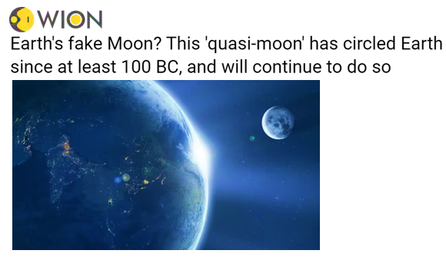
Why In The News?
Experts Believe That It Has Been Orbiting Earth Since 100 BC And Will Continue To Do So For At Least Another 1,500 Years. If All Calculations Are Correct (Or Close To Correct) Then 2023 FW13 Would Be The Most Stable Earth-like Quasi-satellite Ever Discovered.

Slide 5
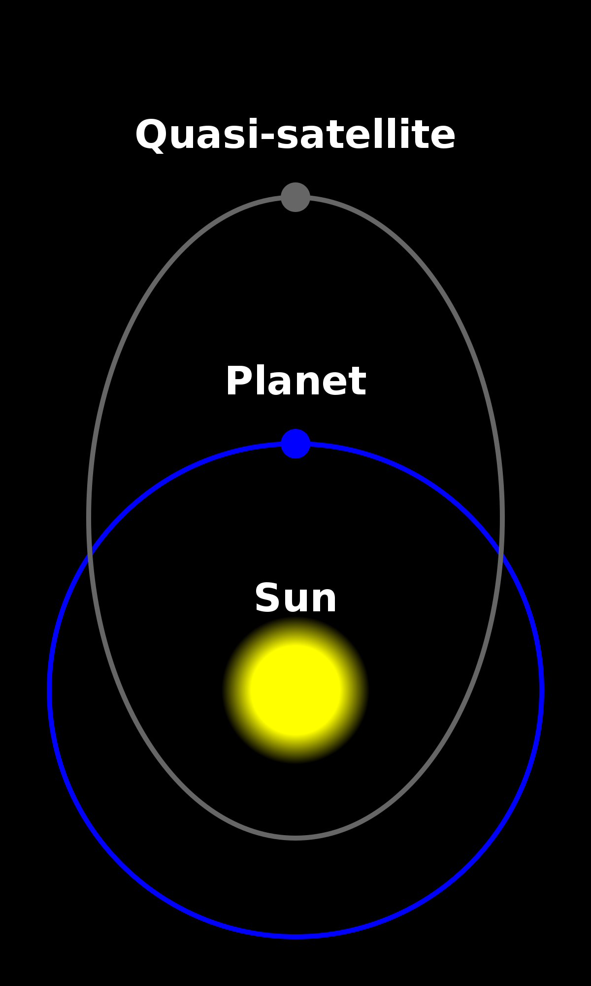
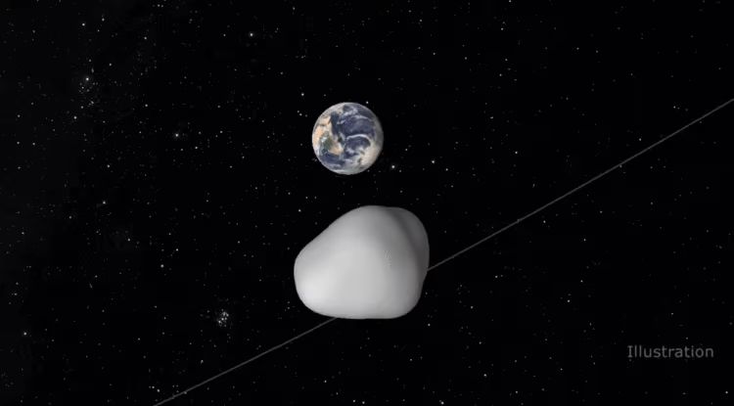
What Are Quasi-Moons?
Quasi-Moons Are Also Known As 'Quasi-Satellites' Because They Appear To Orbit Our Planet In The Same Way That Our Natural Satellite, The Moon.

Slide 6
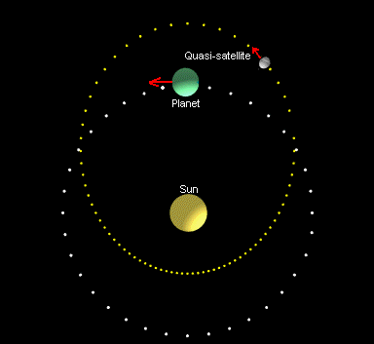
2023 FW13
The New Celestial Object Orbits The Sun In A Similar Time Frame As Earth Does. The Quai-Moon Is Estimated To Be 50 Feet (15 Metres). While Orbiting The Sun, The Quasi-Moon Also Circles The Earth, Coming Within Nine Million Miles (14 Million Kilometres) Of Earth.

Slide 7
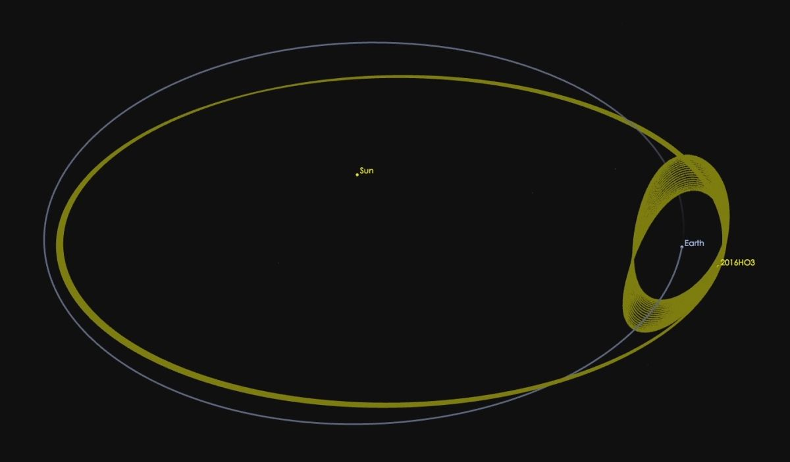
2023 FW13
For Comparison, The Moon Has A Diameter Of 2,159 Miles (3,474 Km) And Comes Within 364,00 Km Of Earth At The Closest Point Of Its Orbit. The Quasi-Moon Has Been Earth's Cosmic Neighbours Since Around 100 BC.

Slide 8
2023 FW13
The Space Rock Will Continue To Follow This Orbital Path Until Around 3700 AD. Notably, This Quasi-satellite Isn't On A Collision Course With Earth Despite Hovering Relatively Close To The Planet.

Slide 9
2023 FW13
The Pan Starrs Observatory First Noticed The Asteroid On March 28. The Discovery Was Officially Revealed On April 1, Following Additional Observations From The Canada France Hawaii Telescope On Mauna Kea, As Well As Observatories On Kitt Peak And Mount Lemmon.

Slide 10
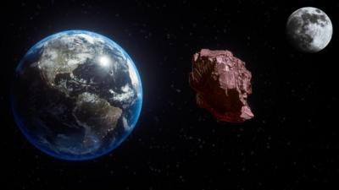
Any Such Earlier Records Of Quasi-Moons?
The Discovery Of The 2023 FW13 Is Nothing New, As A Famous Object, Known As 469219 Kamooalewa, Was Discovered In 2016. At That Time, It Was Thought To Be The Tiniest, Closest, And Most Stable Known Quasi-satellite.

