Slide 2
QUESTION OF THE DAY

Slide 3
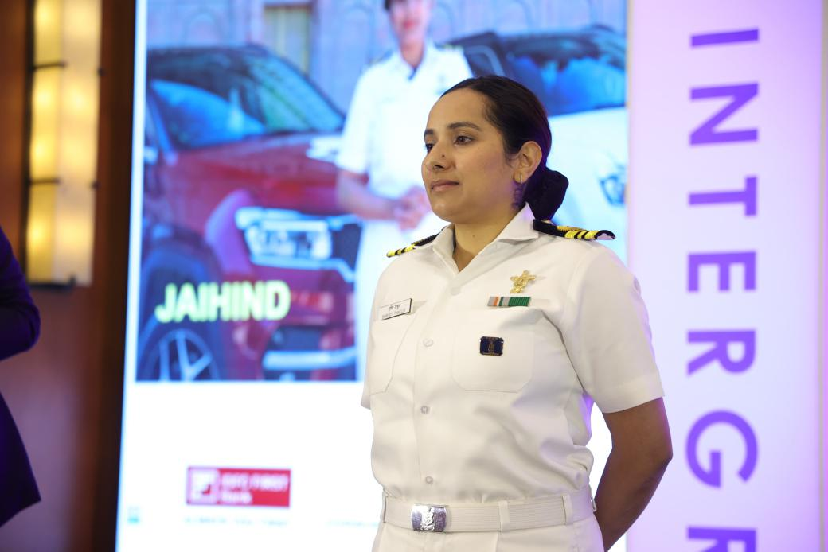
Identify The Rank

Slide 4
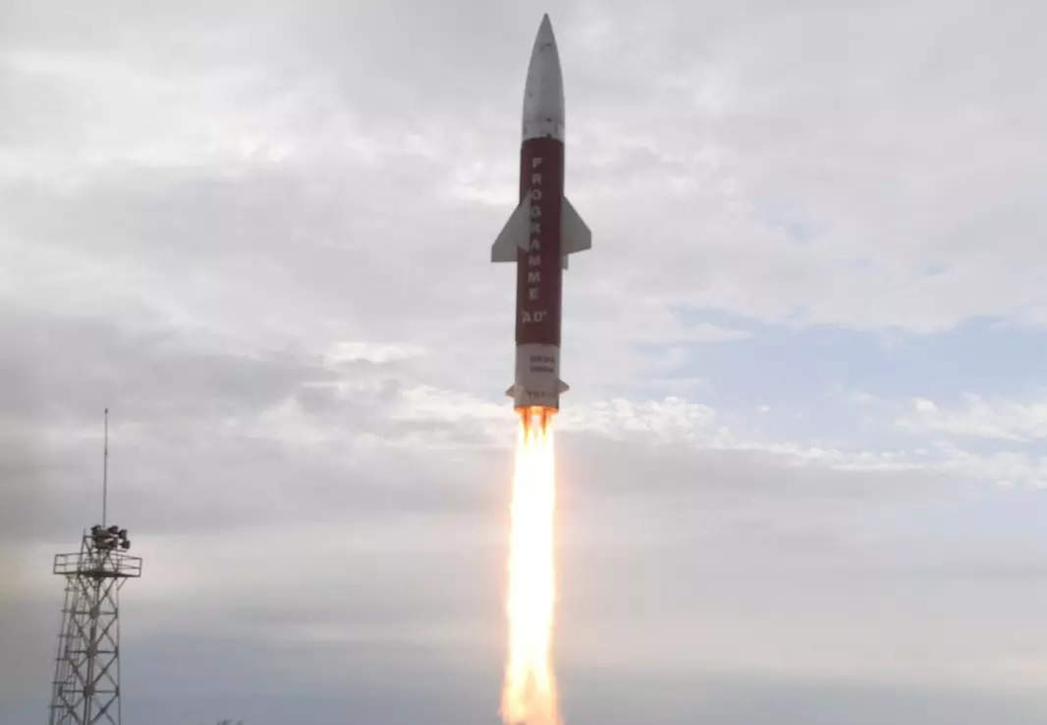
DRDO Successfully Flight-tests Phase-ii Ballistic Missile
DRDO successfully flight-tested Phase-II Ballistic Missile Defence System on July 24, 2024. The Target Missile was launched from LC-IV Dhamra at 1620 hrs mimicking adversary Ballistic Missile, which was detected by weapon system radars deployed on land and sea and activated the AD Interceptor system.

Slide 5
DRDO Successfully Flight-tests Phase-ii Ballistic Missile
The Phase-II AD Endo-atmospheric missile was launched from LC-III at ITR, Chandipurat 1624 hrs. The flight test fully met all the trial objectives validating complete network centric warfare weapon system consisting of Long Range Sensors, low latency communication system and MCC and Advance Interceptor missiles.

Slide 6
DRDO Successfully Flight-tests Phase-ii Ballistic Missile
The test has demonstrated Nation’s indigenous capability to defend against the Ballistic Missiles of 5000 km class. The performance of the missile was monitored from the flight data captured by Range tracking instruments like Electro-Optical Systems, Radar and Telemetry Stations deployed by ITR, Chandipur at various locations including on-board ship.

Slide 7
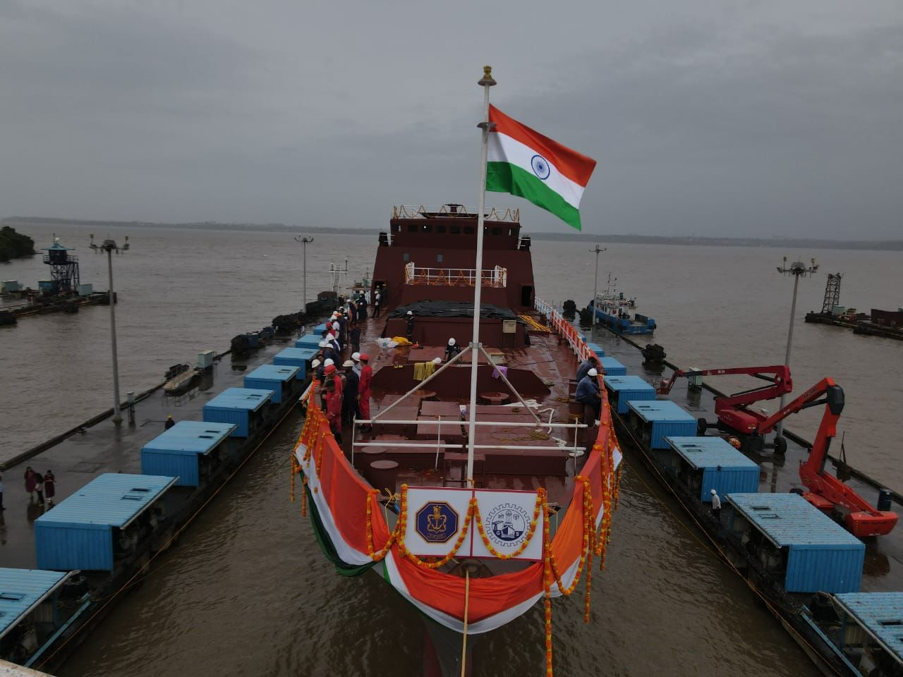
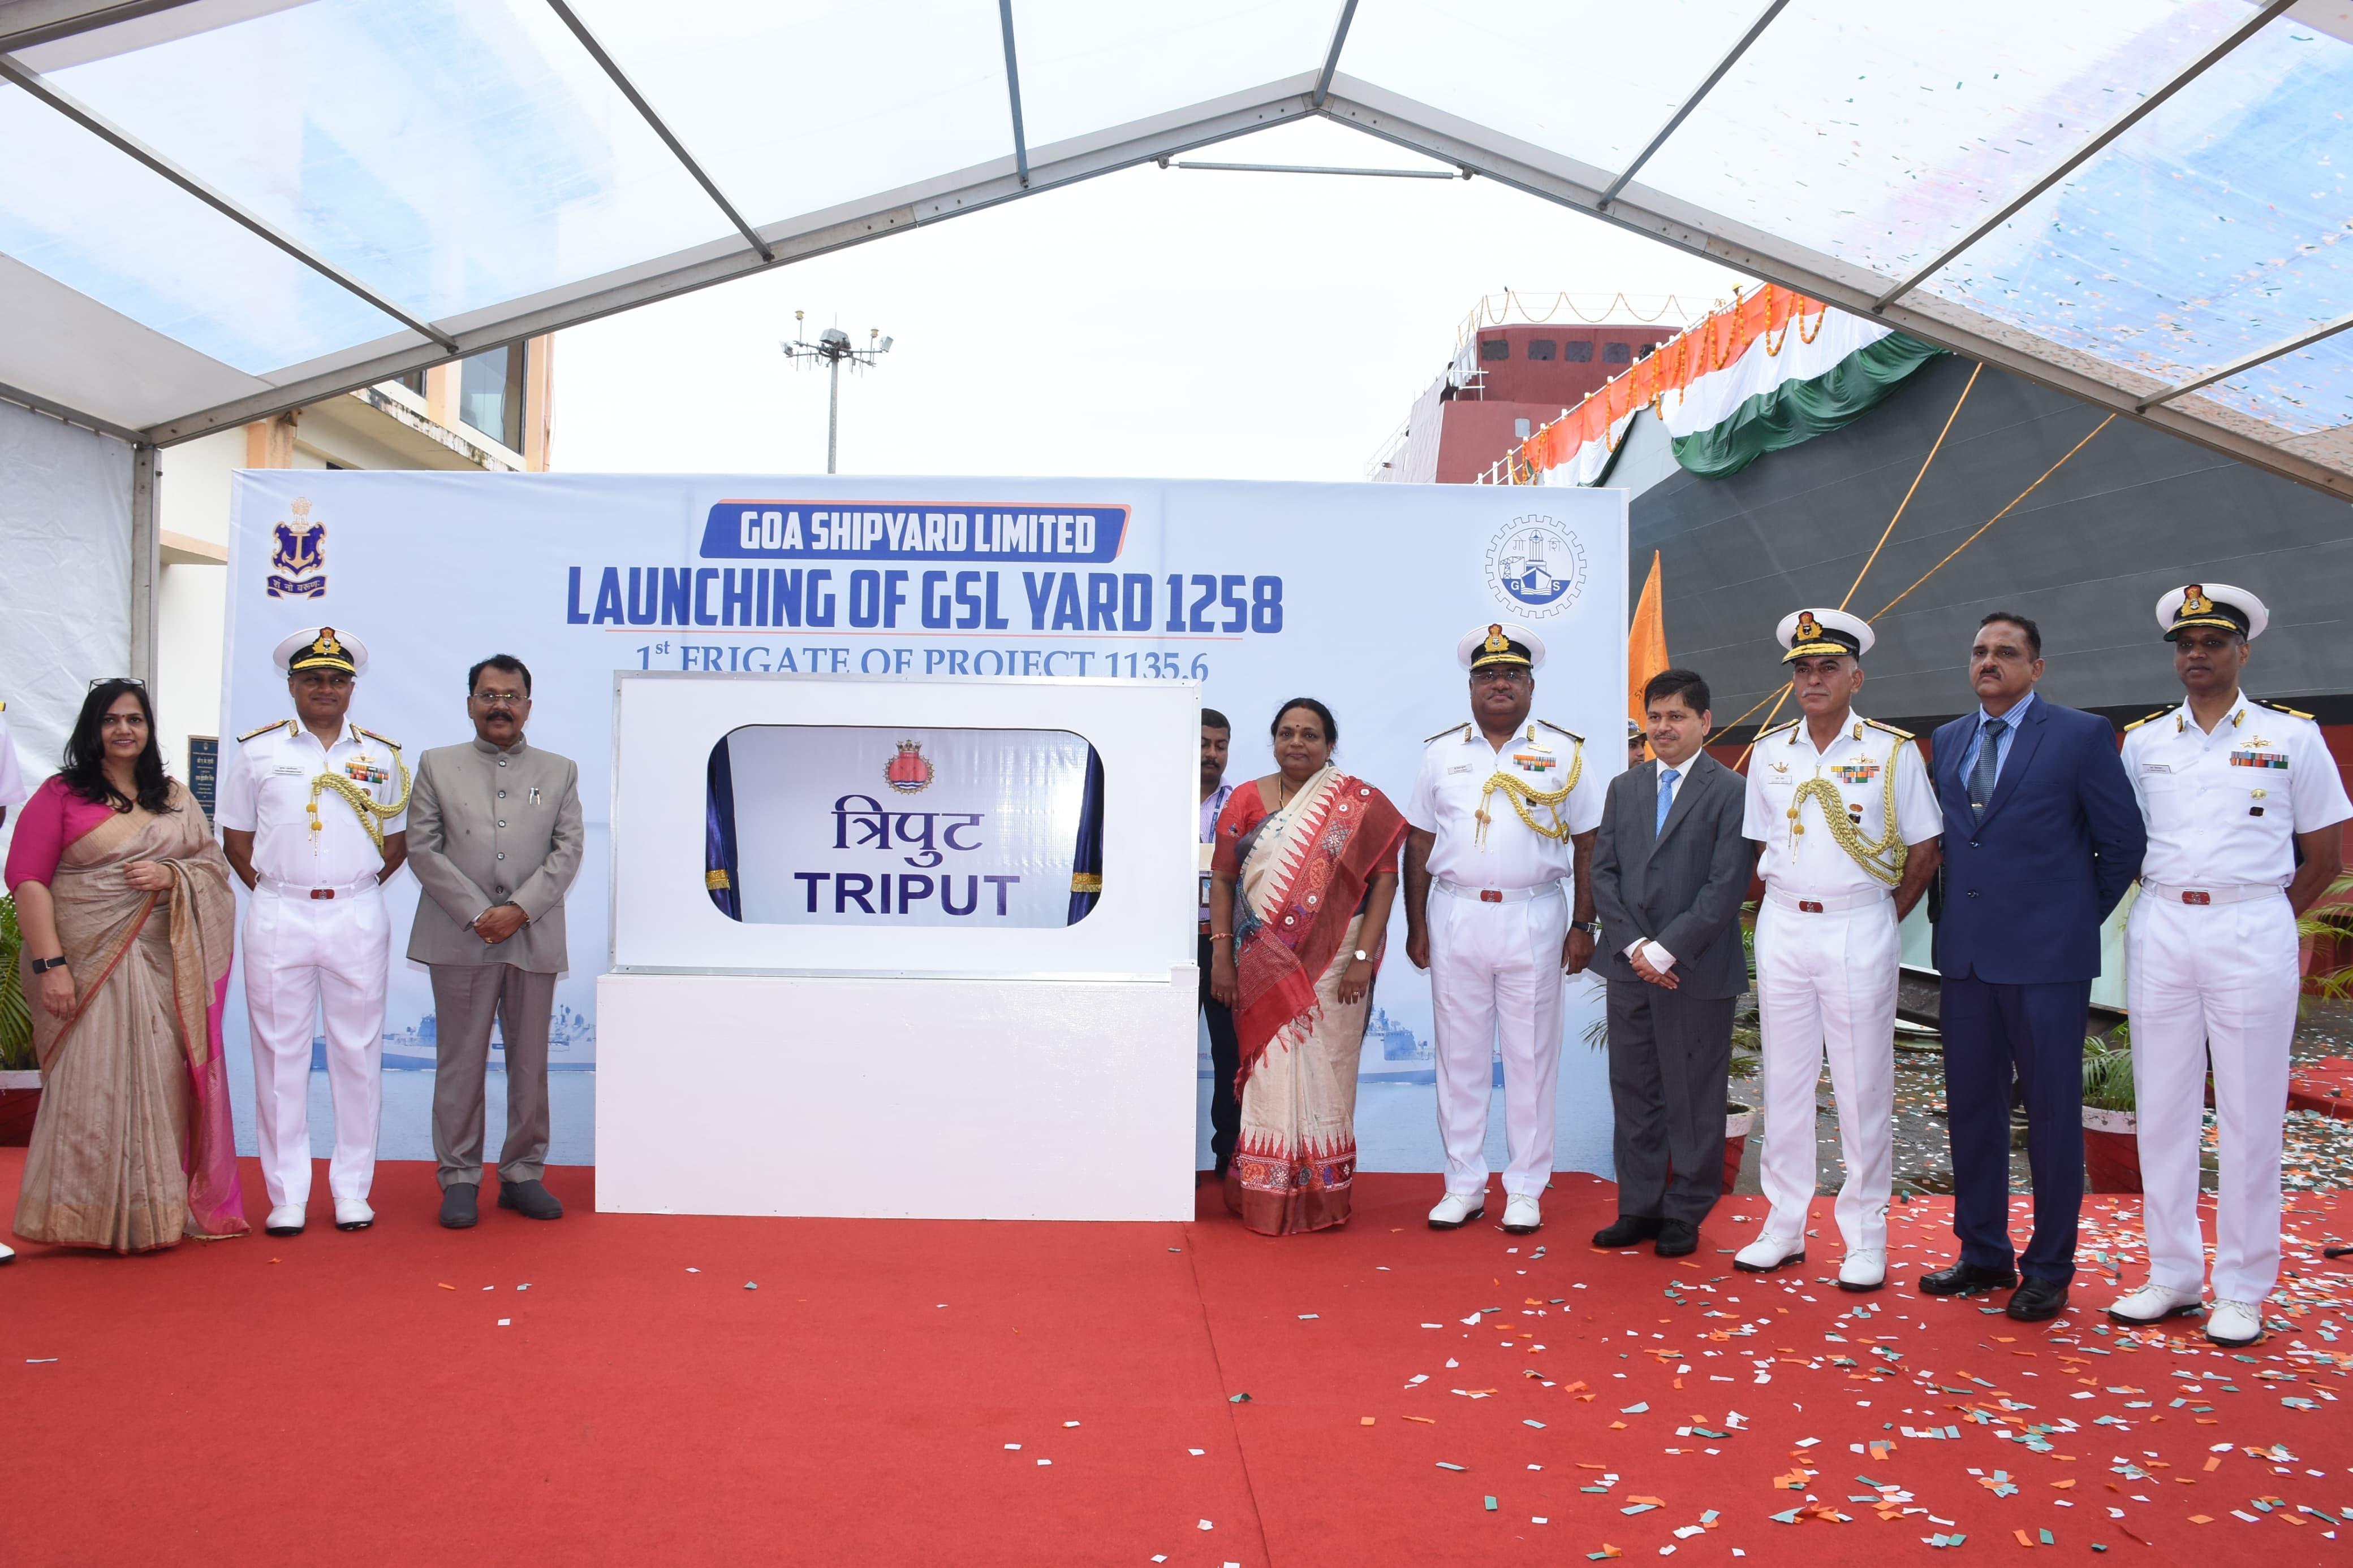
Launch Of ‘Triput’
The first of two Advanced Frigates under construction by Goa Shipyard Limited (GSL) for the Indian Navy, was launched on 23 Jul 24 at GSL, Goa. In keeping with maritime tradition, the ship was launched by Smt Rita Sreedharan to the invocation from Atharva Veda.

Slide 8
Launch Of ‘Triput’
The ship has been named Triput, after the mighty arrow, representing the indomitable spirit of Indian Navy and its ability to strike far and deep.

Slide 9
Launch Of ‘Triput’
The contract for building two Triput class Advance Frigates was signed between the Ministry of Defence and Goa Shipyard Limited on 25 Jan 19. The ship is designed for combat operations against enemy surface ships, submarines and air crafts.

Slide 10
Launch Of ‘Triput’
The Triput class ships are 124.8 m long and 15.2 m wide, with a draught of 4.5 m. Their displacement is approx. 3600 tons and speed a maximum of 28 knots. The ships are equipped with stealth features, advanced weapon & sensors and platform management systems.

Slide 11
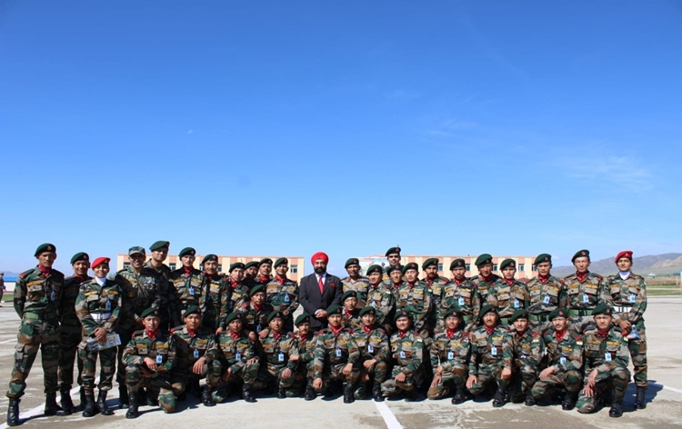
Ex Khaan Quest 2024
The Indian Army contingent will participate in the 21st edition of the multinational joint military exercise Khaan Quest 2024, which is scheduled to be held in Mongolia later this week.

Slide 12
Ex Khaan Quest 2024
The joint military exercise will be held from July 27 to August 9.
Khaan Quest 2024 will be aimed at enhancing the interoperability of the participating nations during peacekeeping missions in a multinational environment.

Slide 13
Ex Khaan Quest 2024
The exercise aims to enhance interoperability of the participating nations during peacekeeping missions in a multinational environment," the Indian Army stated.

Slide 14
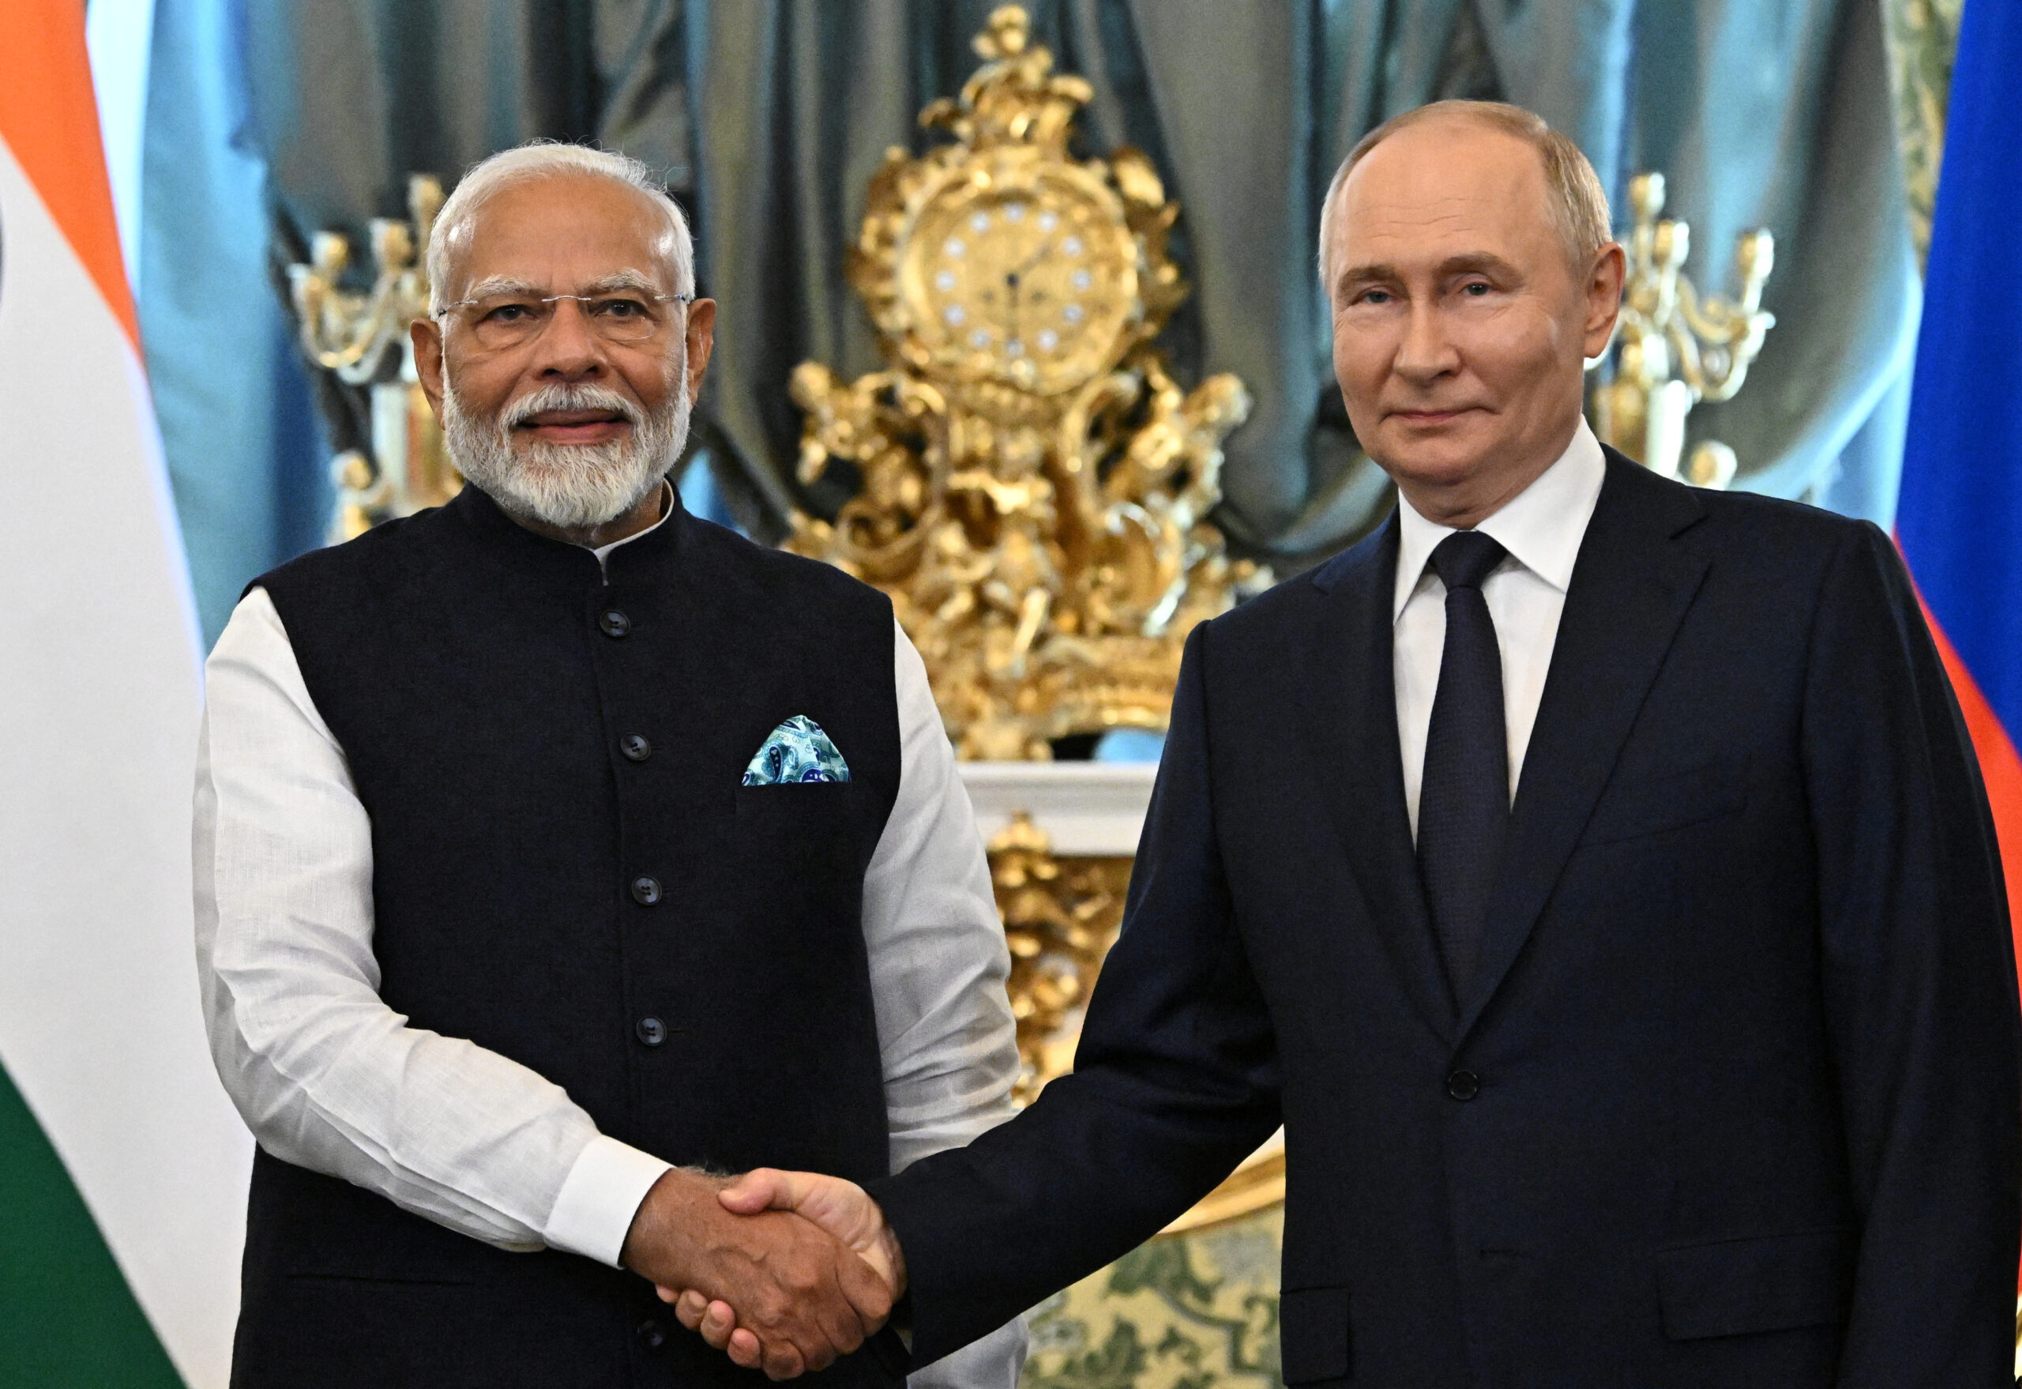
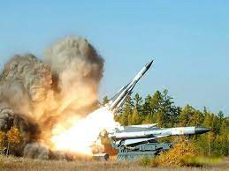
After PM’s Visit, Russia Expedites Supply Missiles
Close on the heels of PM Narendra Modi's Moscow trip for the annual summit, Russia is supplying 120 super long-range Surface-to-Air missiles to India that will give the country's military an edge over Pakistan.

Slide 15
After PM’s Visit, Russia Expedites Supply Missiles
The order was placed following the Balakot air strike when it was felt that India required such long-range missiles to have an edge over Pakistan. Subsequently, an order was placed with Russia for supplies of long-range Surface-to-Air missiles.

Slide 16
After PM’s Visit, Russia Expedites Supply Missiles
The Surface-to-Air missiles being supplied are considered among the best in the world and have a range of about 400 kms. Russia has been responding to India's requests on defence requirements during critical junctures.

Slide 17
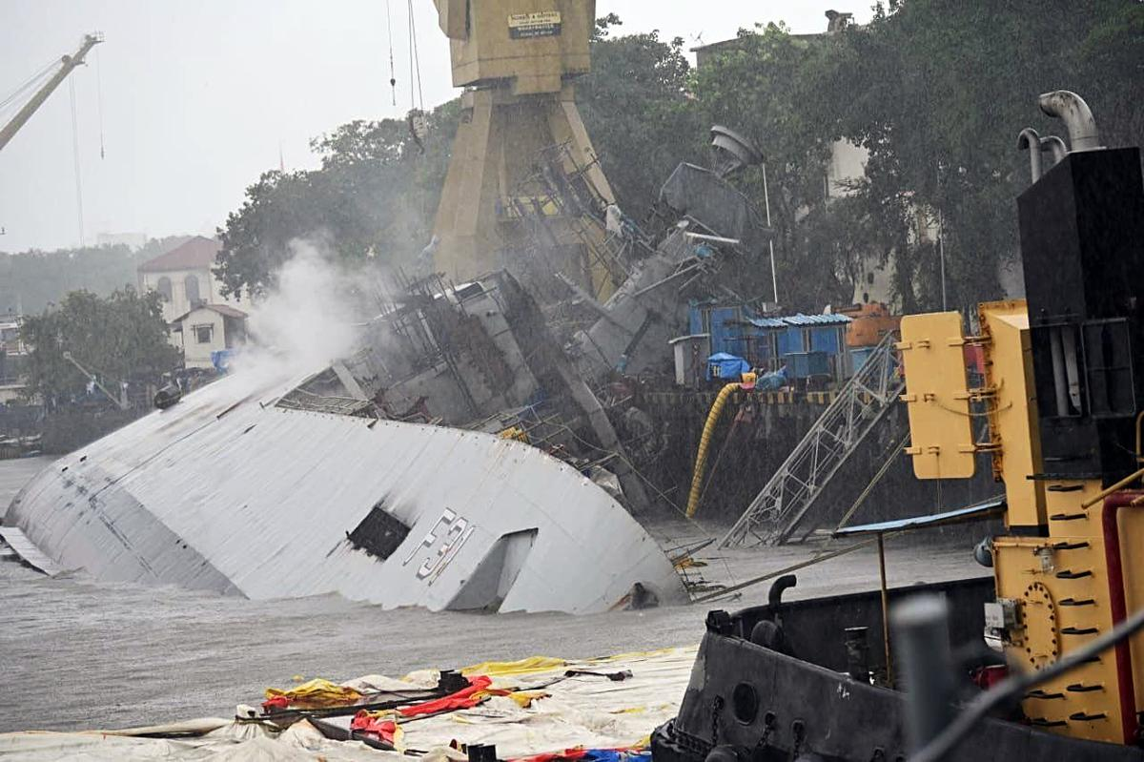
Update On Incident Onboard INS Brahmaputra
Following the unfortunate incident of INS Brahmaputra in Naval Dockyard Mumbai, Adm Dinesh K Tripathi, CNS visited Mumbai on 23 Jul 24. He reviewed the sequence of events leading to the accident and efforts undertaken to locate the missing sailor.

Slide 18
Update On Incident Onboard INS Brahmaputra
The CNS was briefed on the mitigating actions taken to limit the extent of the damage, plan to recover and undertake repairs to restore the ship's functionality at the earliest. The CNS directed that all actions by the Command and Naval Headquarters to make INS Brahmaputra seaworthy and combat ready are to be initiated immediately.

Slide 19
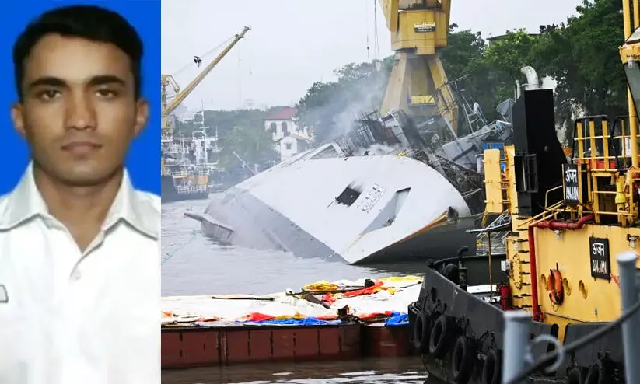
Update On Incident Onboard INS Brahmaputra
Adm Dinesh K Tripathi, CNS and all personnel of Indian Navy extend their deepest condolences to the family of Sitendra Singh, Leading Seaman. The Indian Navy stands resolutely with the bereaved family in this hour of grief.

Slide 22
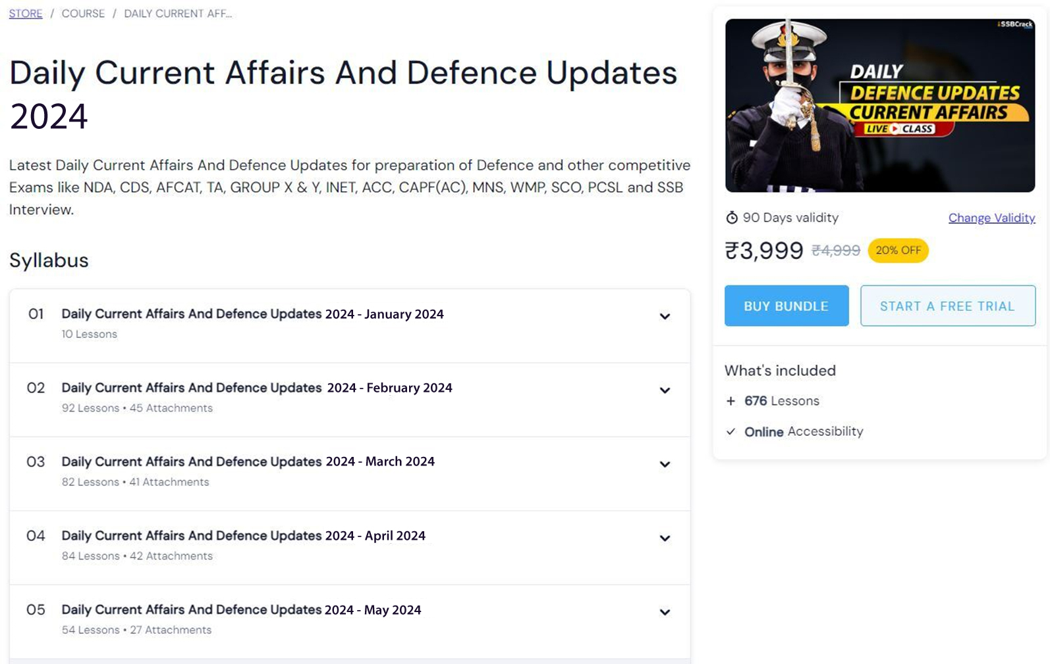

Slide 24
REVIEW QUESTIONS

Slide 25
Where was the first of two Advanced Frigates for the Indian Navy launched?
Mazagon Dock Shipbuilders Limited (MDL)
Cochin Shipyard Limited (CSL)
Goa Shipyard Limited (GSL)
Hindustan Shipyard Limited (HSL)

Slide 26
Where was the first of two Advanced Frigates for the Indian Navy launched?
Mazagon Dock Shipbuilders Limited (MDL)
Cochin Shipyard Limited (CSL)
Goa Shipyard Limited (GSL)
Hindustan Shipyard Limited (HSL)

Slide 27
Where was the Phase-II Ballistic Missile Defence System successfully flight-tested by DRDO?
ITR Chandipur
Mumbai
Chennai
None

Slide 28
Where was the Phase-II Ballistic Missile Defence System successfully flight-tested by DRDO?
ITR Chandipur
Mumbai
Chennai
None

Slide 29
In which country is the 21st edition of the exercise Khaan Quest 2024 scheduled to be held?
India
Mongolia
Russia
China

Slide 30
In which country is the 21st edition of the exercise Khaan Quest 2024 scheduled to be held?
India
Mongolia
Russia
China

Slide 31
Ex ‘LAMITIYE’ Conducted b/w India &
Qatar
Oman
UAE
Seychelles

Slide 32
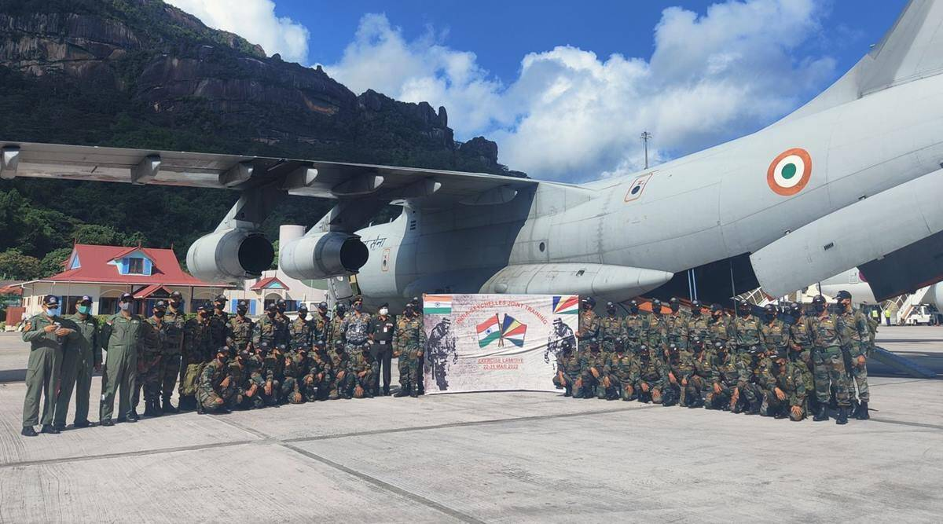
Ex ‘LAMITIYE’ Conducted b/w India &
Qatar
Oman
UAE
Seychelles

Slide 33
Chinook Chopper Manufactured By
Airbus
Lockheed Martin
Boeing
HAL

Slide 34
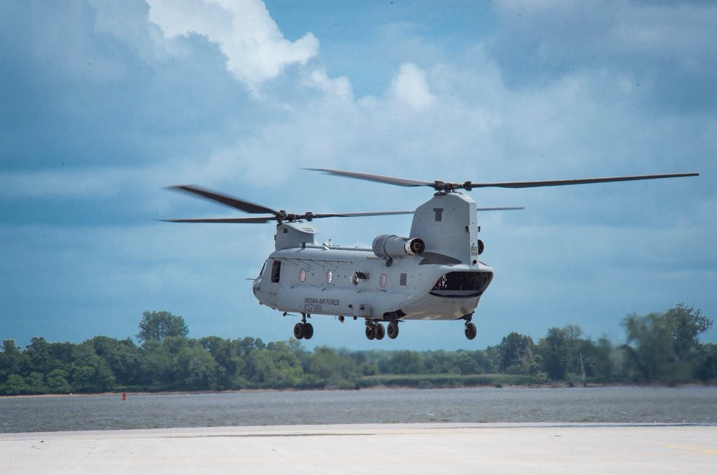
Chinook Chopper Manufactured By
Airbus
Lockheed Martin
Boeing
HAL

Slide 35
Army War College Is In
Mhow
New Delhi
Noida
Nagpur

Slide 36
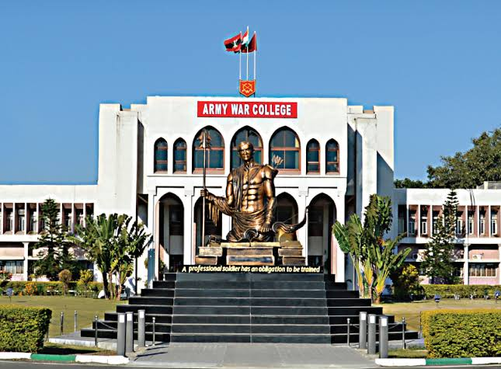
Army War College Is In
Mhow
New Delhi
Noida
Nagpur

Slide 37
SFDR Stands For
Solid Fuel Ductile Ramjet
Solid Fuel Ducted Ram
Solid Fuel Ducted Rocket
Solid Fuel Ducted Ramjet

Slide 38
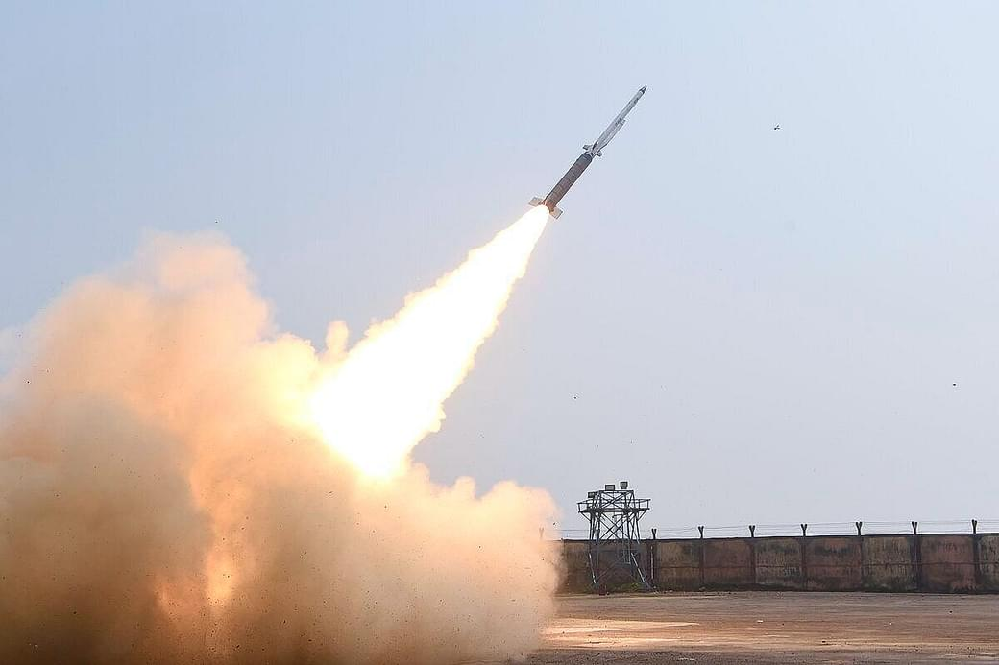
SFDR Stands For
Solid Fuel Ductile Ramjet
Solid Fuel Ducted Ram
Solid Fuel Ducted Rocket
Solid Fuel Ducted Ramjet

Slide 39
Allocation of Funds to Which Security Forces Is High?
Indo- China Border
Indo-Myanmar Border
Indo- Bangladesh Border
None of these

Slide 40
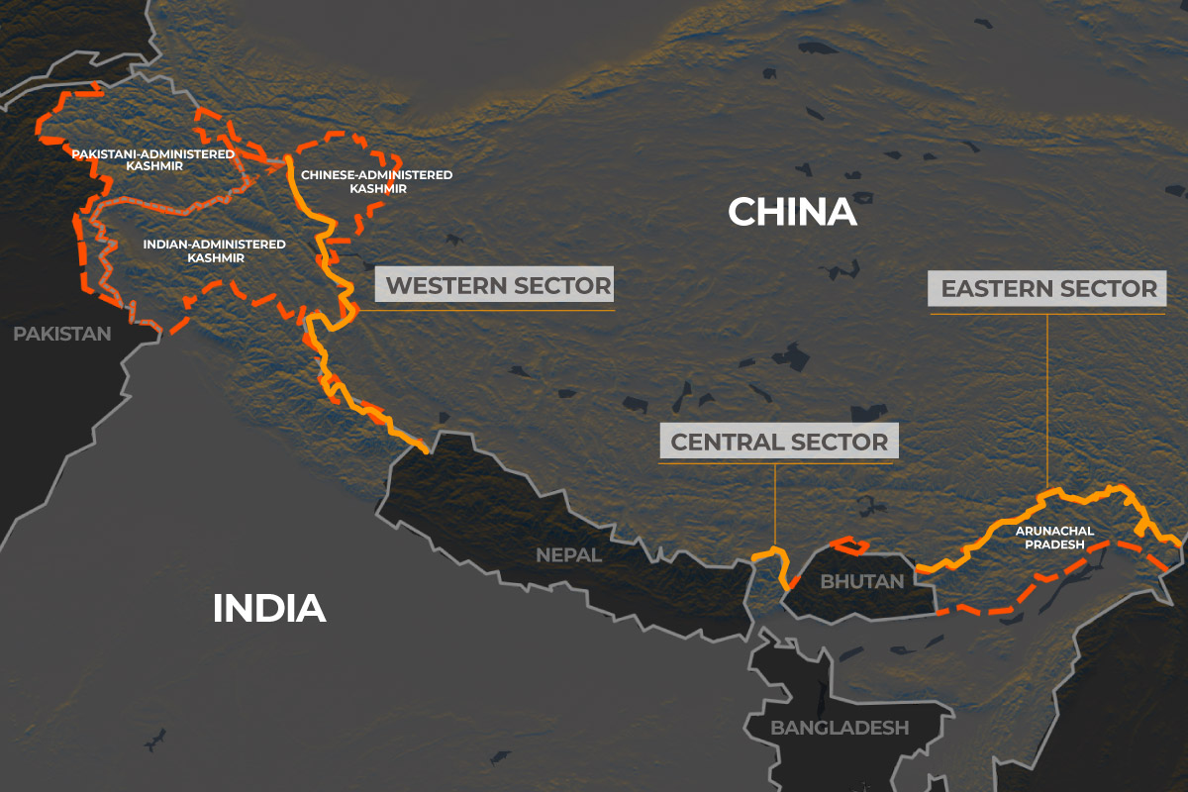
Allocation of Funds to Which Security Forces Is High?
Indo- China Border
Indo-Myanmar Border
Indo- Bangladesh Border
None of these

Slide 41
Wing Commander Rank Of IAF Is Equivalent to __ Rank of Indian Navy.
Commander
Lieutenant
Admiral
Captain

Slide 42
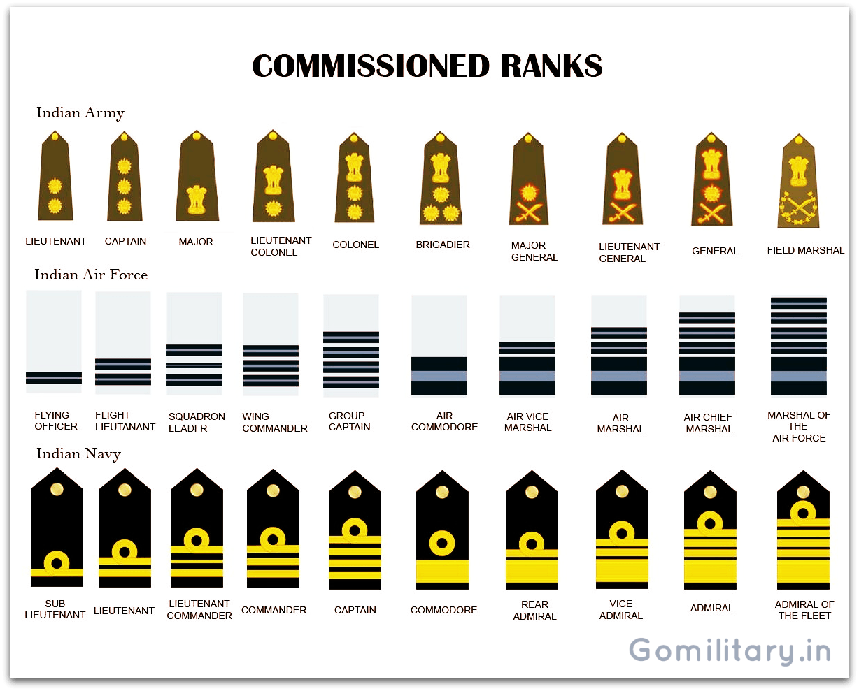
Wing Commander Rank Of IAF Is Equivalent to __ Rank of Indian Navy.
Commander
Lieutenant
Admiral
Captain

Slide 43
FSSAI Stands For
Food Safety and Standards Authority of Iran
Food Safety and Stand Authority of India
Food Safety and Standards Authority of India
None of the above

Slide 44
FSSAI Stands For
Food Safety and Standards Authority of Iran
Food Safety and Stand Authority of India
Food Safety and Standards Authority of India
None of the above

Slide 45
Ilyushin Il-38 Is A
Maritime patrol Aircraft
Ship
Tank
Anti Tank Missile

Slide 46
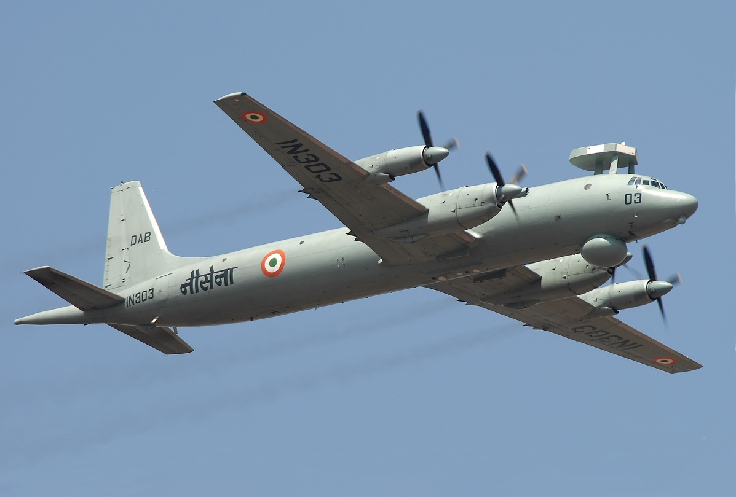
Ilyushin Il-38 Is A
Maritime patrol Aircraft
Ship
Tank
Anti Tank Missile

Slide 47
Indian Ocean Naval Symposium (IONS) Maritime Exercise 2022 (IMEX-22) was conducted at
Pacific Ocean
Bay of Bengal
Arabian Sea
Goa and in Arabian Sea

Slide 48
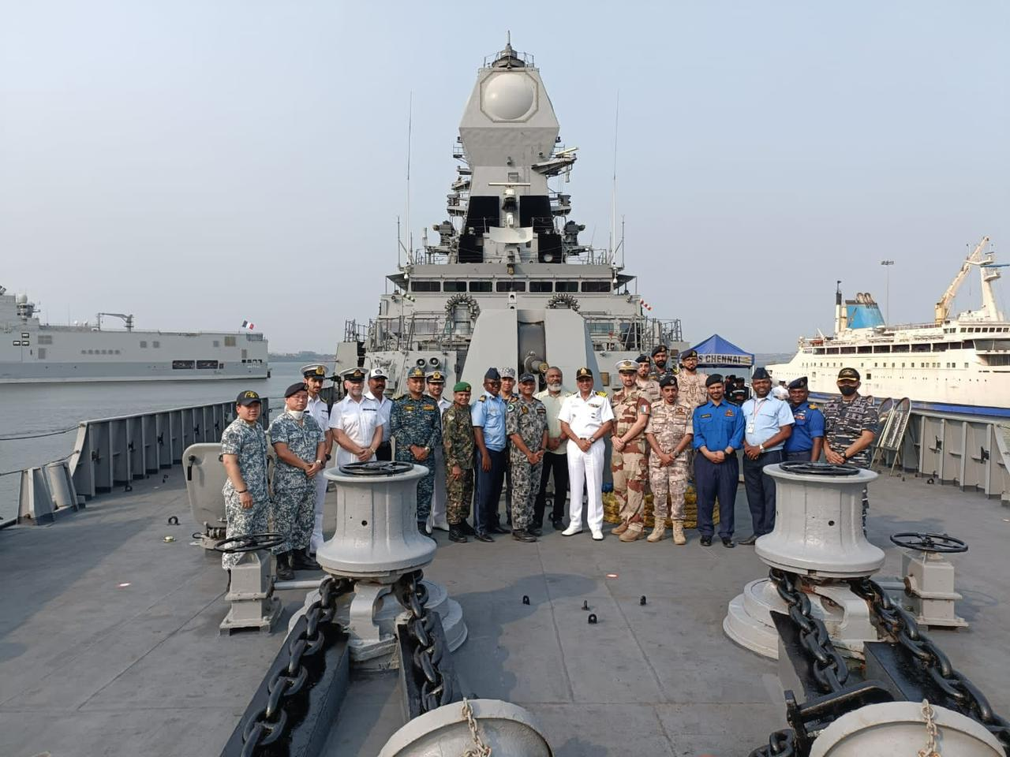
Indian Ocean Naval Symposium (IONS) Maritime Exercise 2022 (IMEX-22) was conducted at
Pacific Ocean
Bay of Bengal
Arabian Sea
Goa and in Arabian Sea

Slide 49
Ex ‘BLUE FLAG’ conducted b/w India &
Qatar
Oman
UAE
Israel

Slide 50
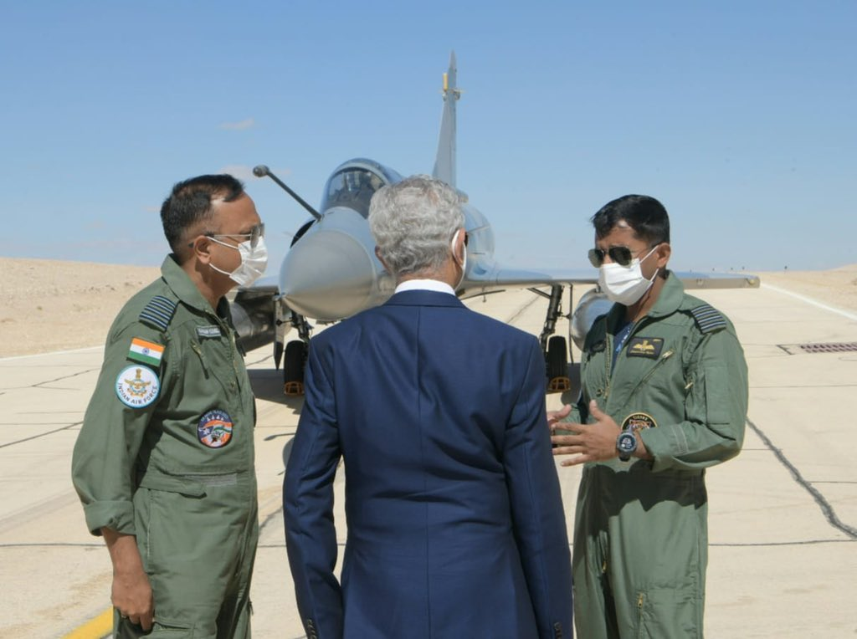
Ex ‘BLUE FLAG’ conducted b/w India &
Qatar
Oman
UAE
Israel

Slide 51
President's Bodyguard Motto Is
Jai Hind
Sarvda Shaktishali
Bharat Mata Ki Jai
Rashtra Pratham

Slide 52
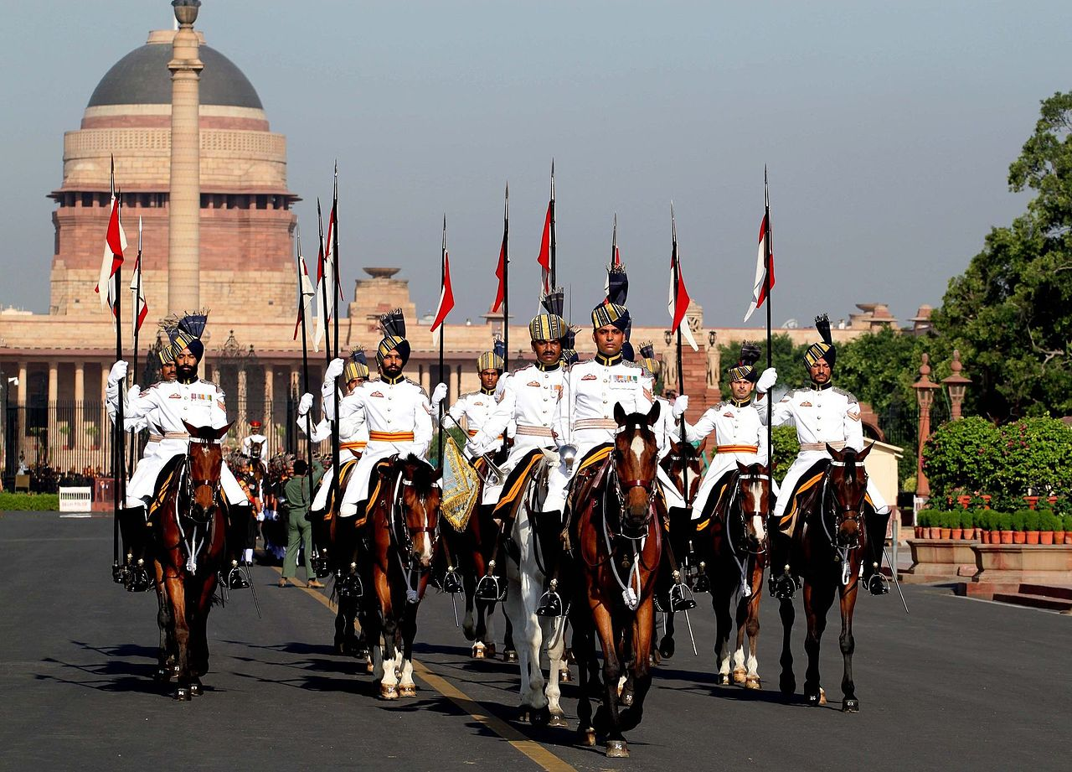
President's Bodyguard Motto Is
Jai Hind
Sarvda Shaktishali
Bharat Mata Ki Jai
Rashtra Pratham

Slide 53
Military College of Electronics and Mechanical Engineering Is At
Imphal
Mhow
Secunderabad
Vairengte

Slide 54
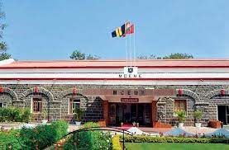
Military College of Electronics and Mechanical Engineering Is At
Imphal
Mhow
Secunderabad
Vairengte

Slide 55
‘Translating Myself and Others’ Book Is Written By
Jhumpa Lahiri
Dr. Prabhleen Singh
Chetan Bhagat
Nirupama Rao

Slide 56
‘Translating Myself and Others’ Book Is Written By
Jhumpa Lahiri
Dr. Prabhleen Singh
Chetan Bhagat
Nirupama Rao

Slide 57
Muscat Is The Capital Of
Oman
Qatar
UAE
Maldives

Slide 58
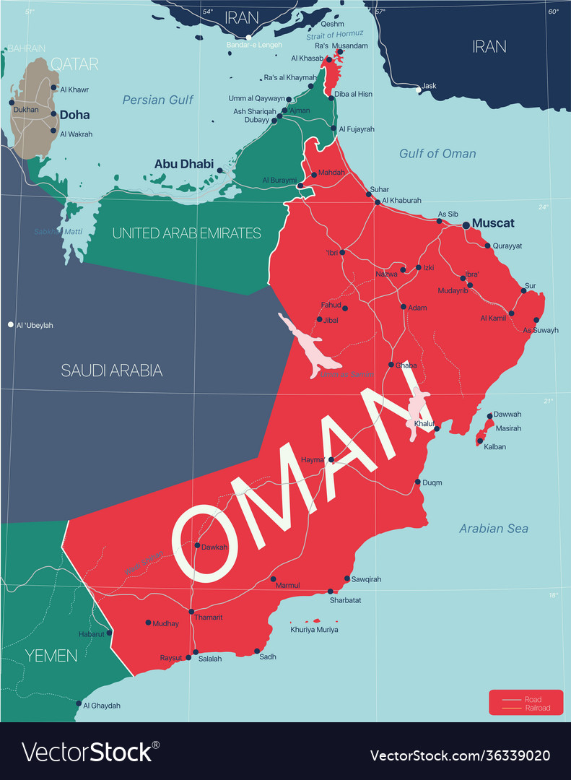
Muscat Is The Capital Of
Oman
Qatar
UAE
Maldives

Slide 59
Where Is The Hq Of The Southern Western Air Command of The IAF?
Gandhinagar
Vishakhapatnam
Pune
Mumbai

Slide 60
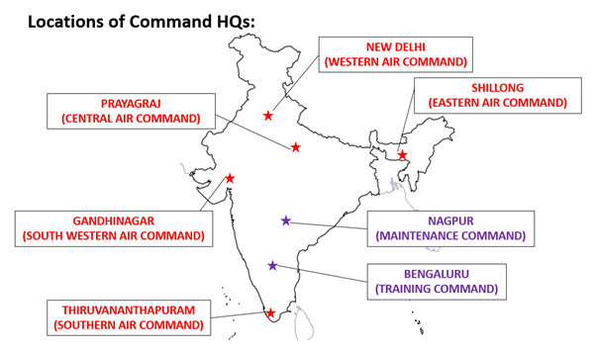
Where Is The Hq Of The Southern Western Air Command of The IAF?
Gandhinagar
Vishakhapatnam
Pune
Mumbai

Slide 61
Current DG Of ICG Is
MM Naravane
V S Pathania
Anil Deshmukh
Vivek Jacob

Slide 62
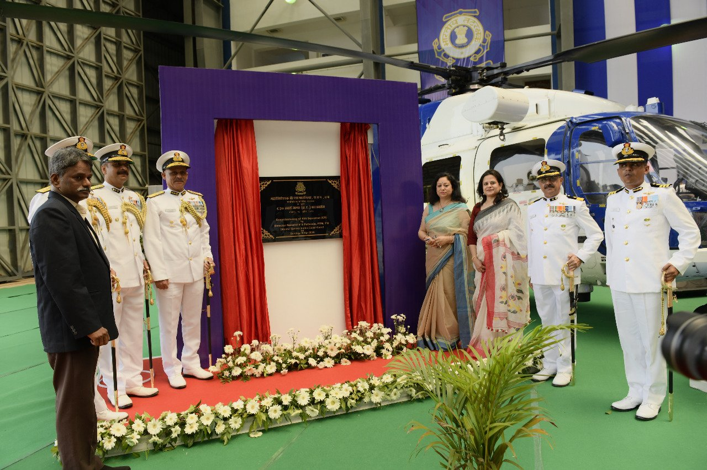
Current DG Of ICG Is
MM Naravane
V S Pathania
Anil Deshmukh
Vivek Jacob

Slide 64
QUESTION OF THE DAY

Slide 65
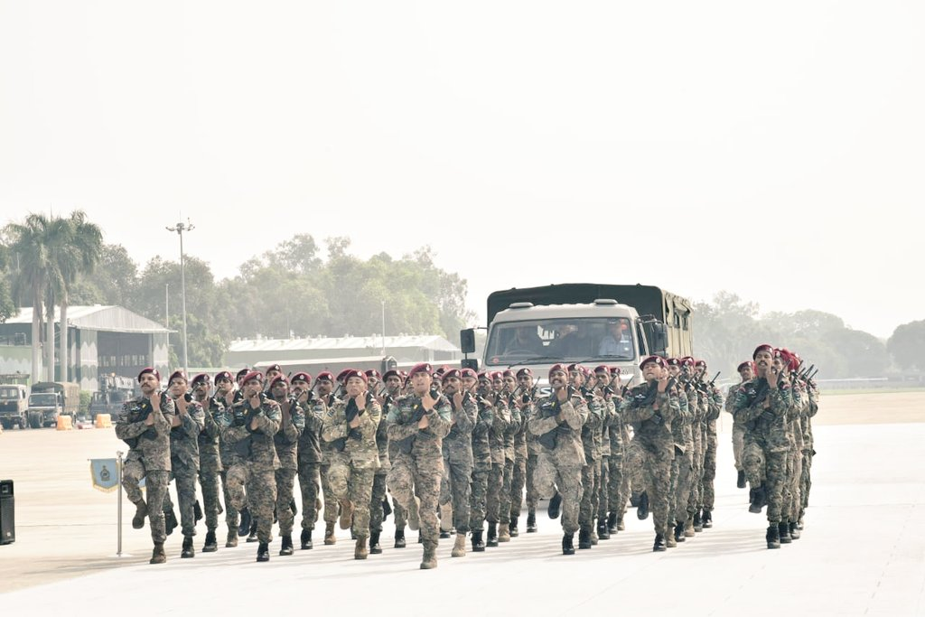
Identify The Force

Slide 66
Identify The Force
Answer In The Next Session

