Slide 1


Slide 2


QUESTION OF THE DAY

Slide 3
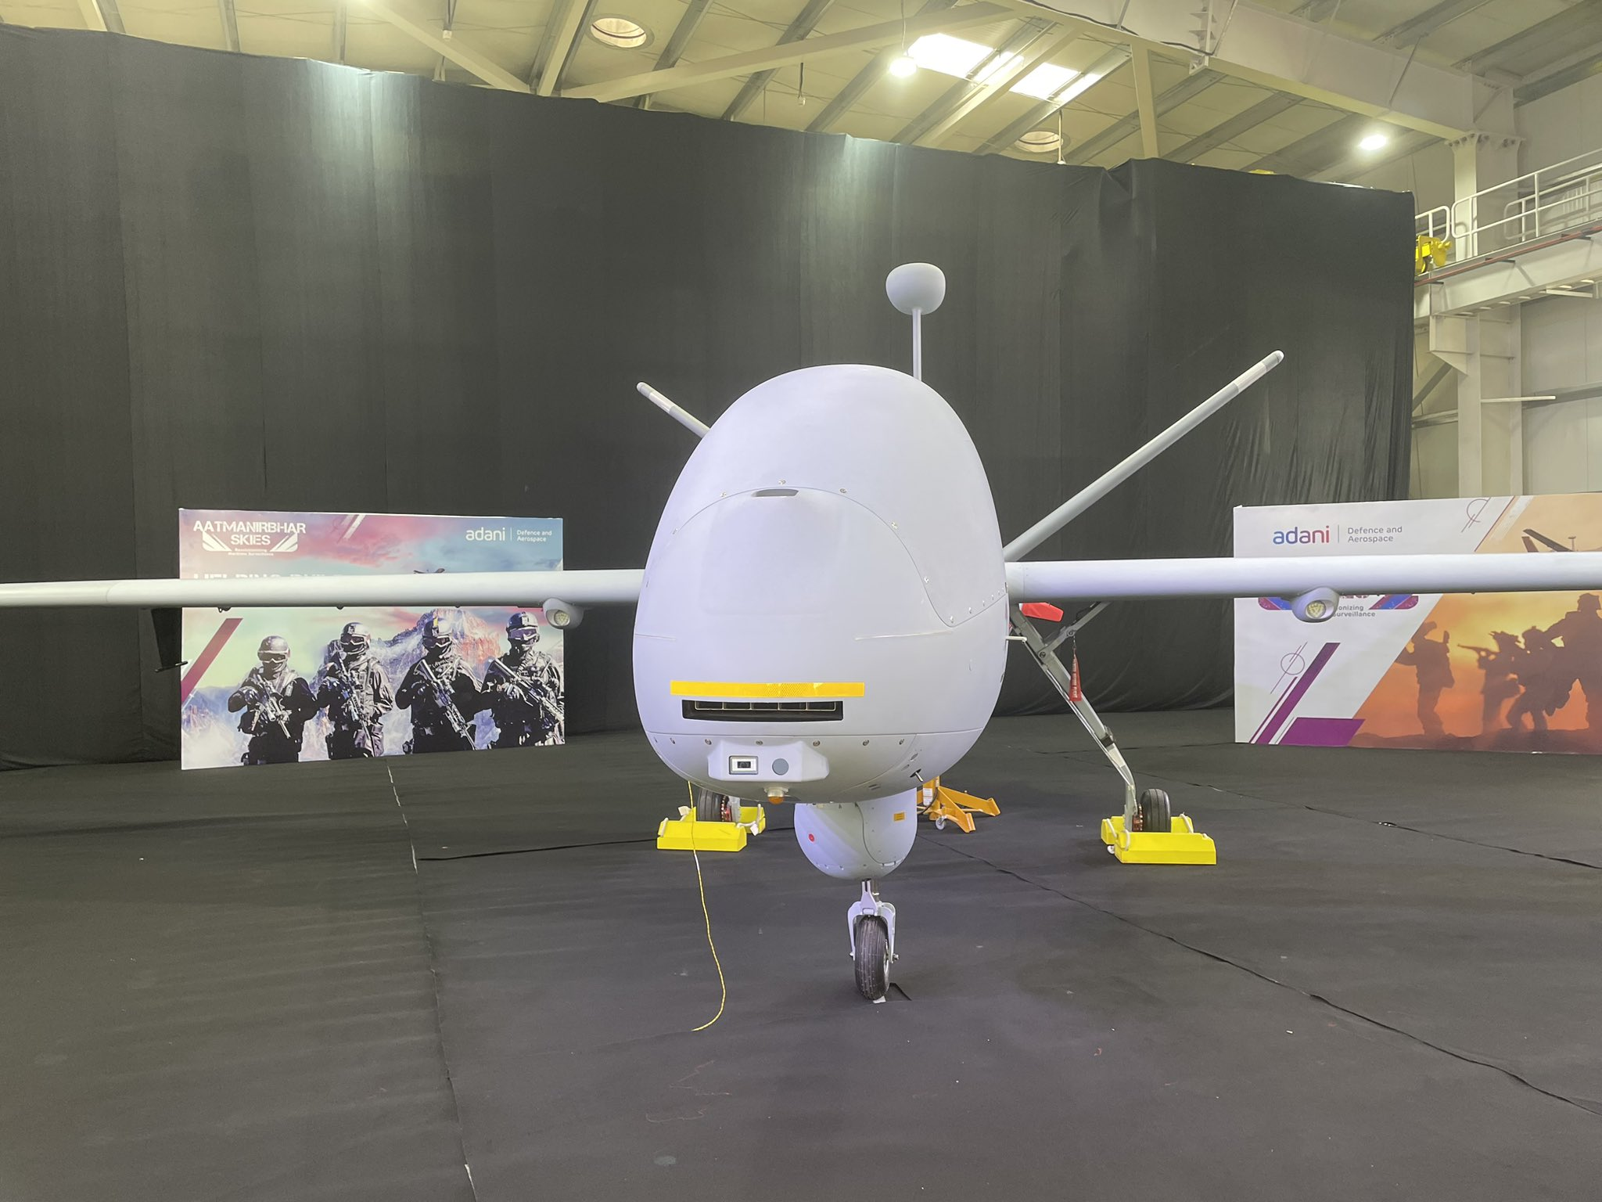

Identify The UAV

Slide 4
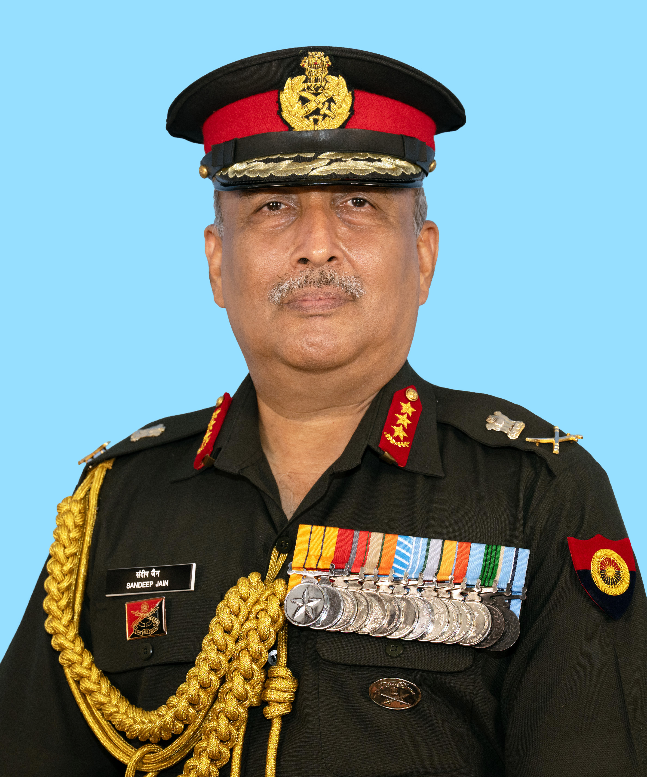
Major Defence Leadership Appointments
Lieutenant General Sandeep Jain, AVSM, SM assumed the appointment of Vice Chief of the Army Staff (VCOAS). An alumnus of the National Defence Academy (NDA), Lt Gen Sandeep Jain was commissioned into the MAHAR Regiment in June 1988.

Slide 5
Major Defence Leadership Appointments
During his nearly 38 years of distinguished service, he has held several important command and staff appointments across diverse operational areas. Before becoming the VCOAS, Lt Gen Sandeep Jain served as the General Officer Commanding-in-Chief (GOC-in-C), Southern Command.

Slide 6
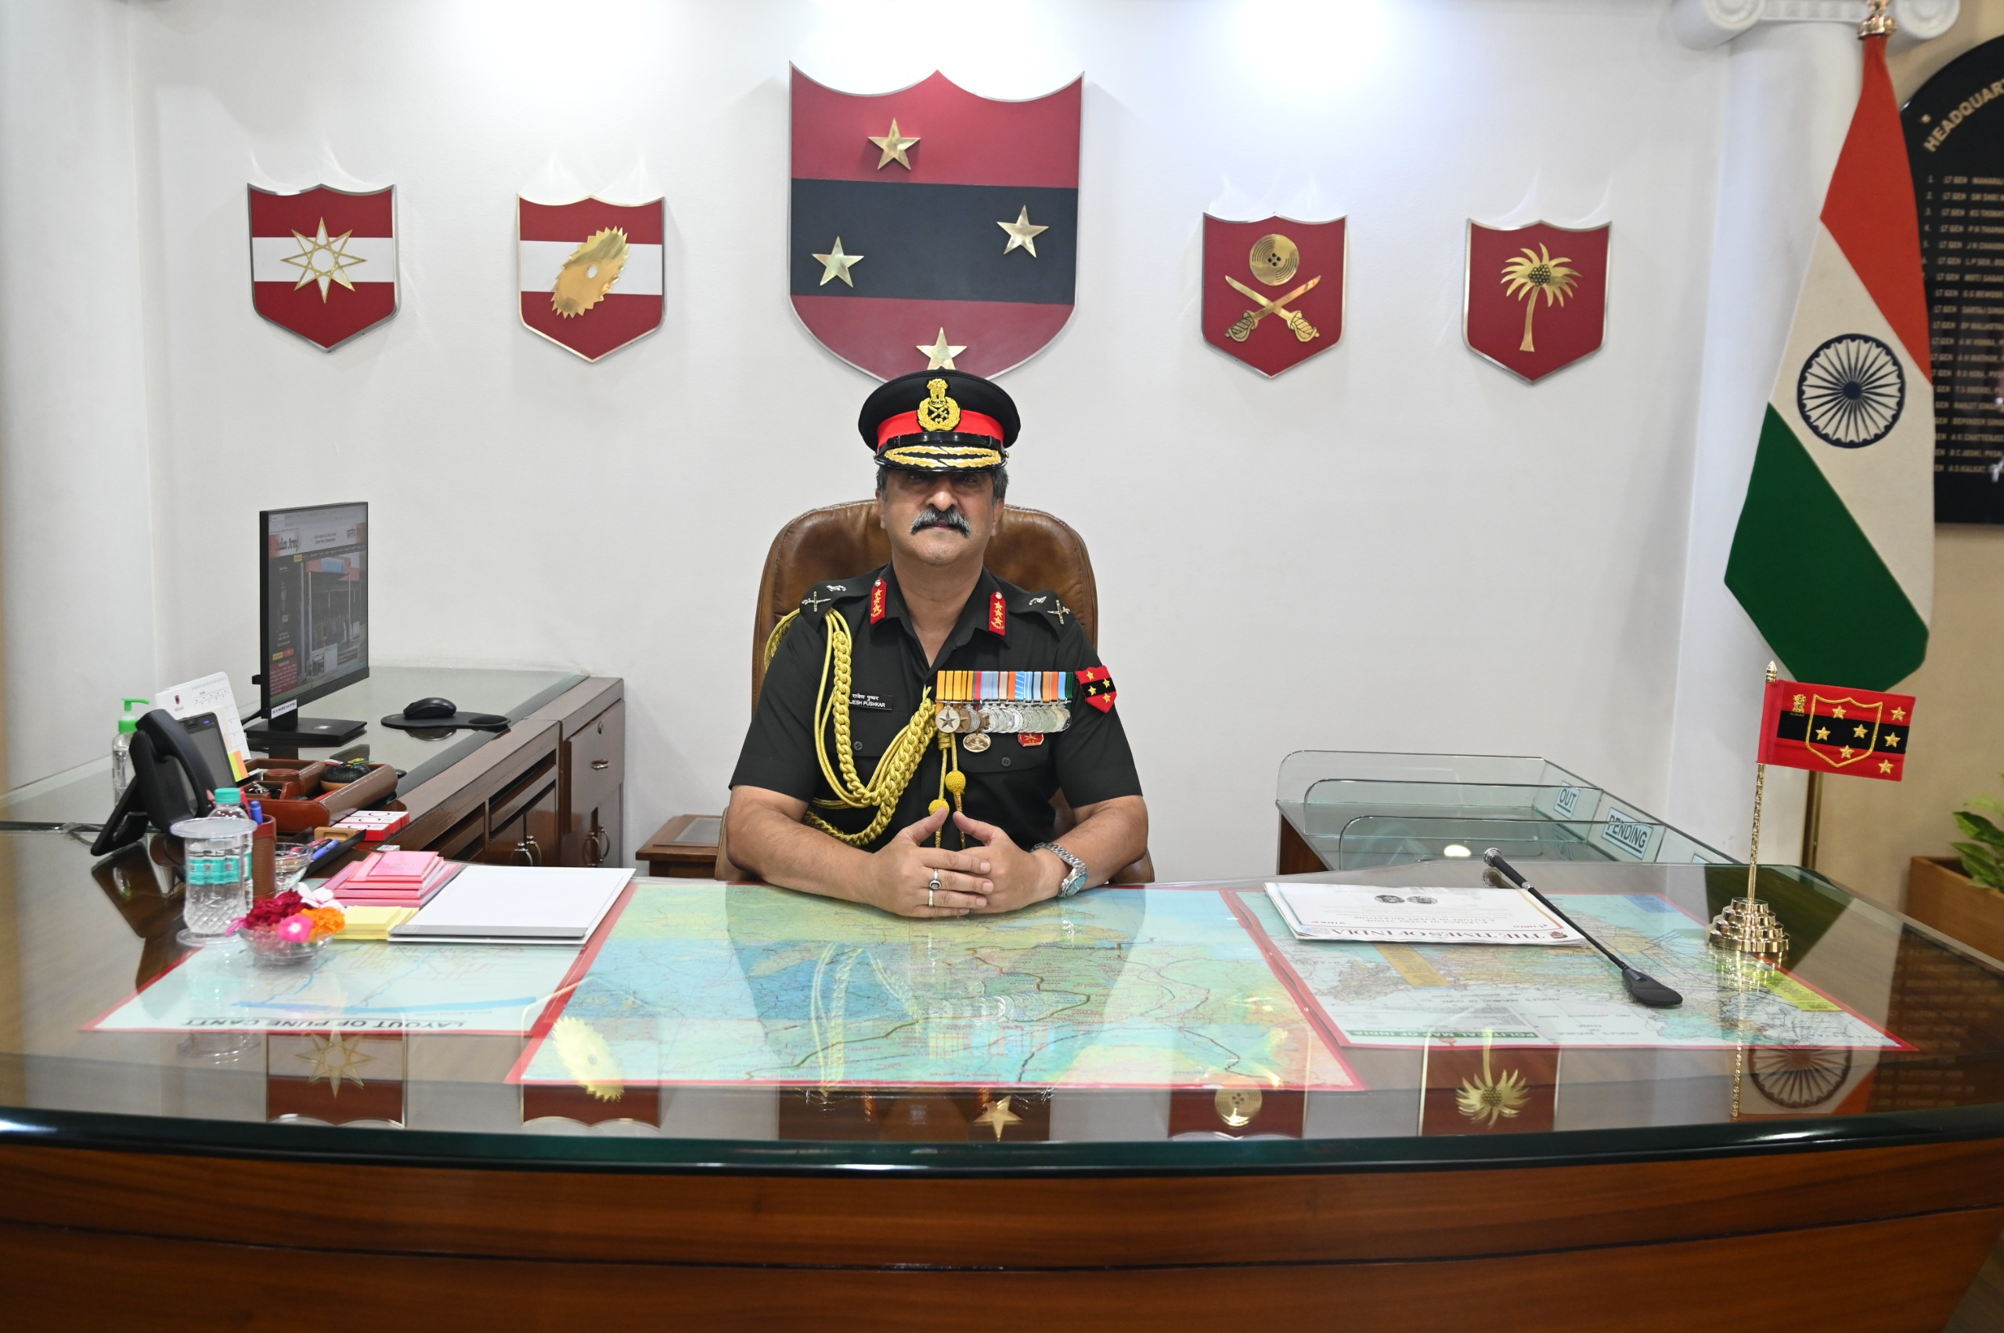
Major Defence Leadership Appointments
Lieutenant General Rajesh Pushkar, AVSM, VSM assumed charge as the General Officer Commanding-in-Chief (GOC-in-C), Southern Command on 1 July 2026, succeeding Lt Gen Sandeep Jain.

Slide 7
Major Defence Leadership Appointments
Lieutenant General Rajesh Pushkar, AVSM, VSM assumed charge as the General Officer Commanding-in-Chief (GOC-in-C), Southern Command on 1 July 2026, succeeding Lt Gen Sandeep Jain.

Slide 8
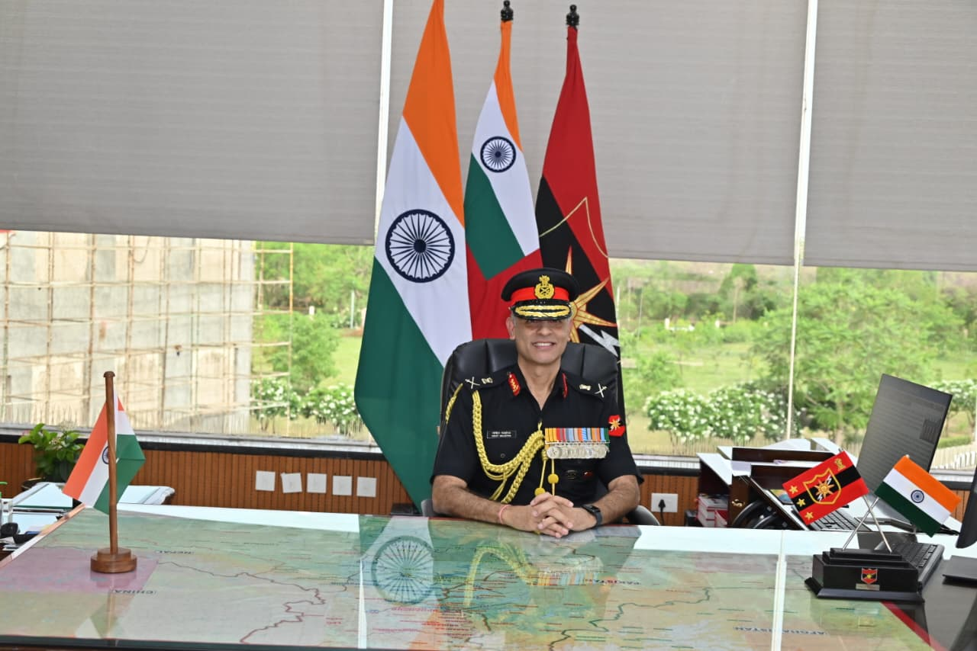
Major Defence Leadership Appointments
Lieutenant General Mohit Malhotra, AVSM, SM took over as the General Officer Commanding-in-Chief (GOC-in-C), South Western Command.

Slide 9
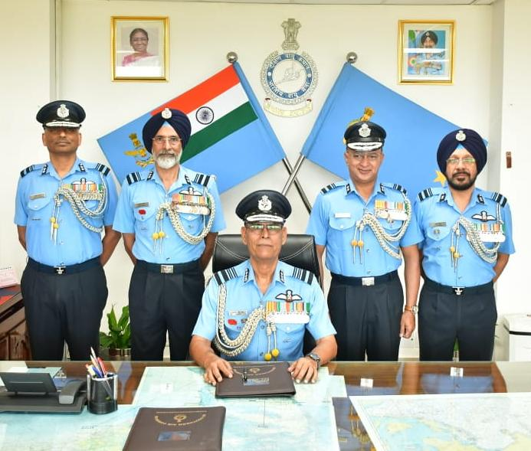
Major Defence Leadership Appointments
Air Marshal Jasvir Singh Mann, AVSM, VSM assumed command as the Air Officer Commanding-in-Chief (AOC-in-C), Southern Air Command on 1 July 2026.

Slide 10
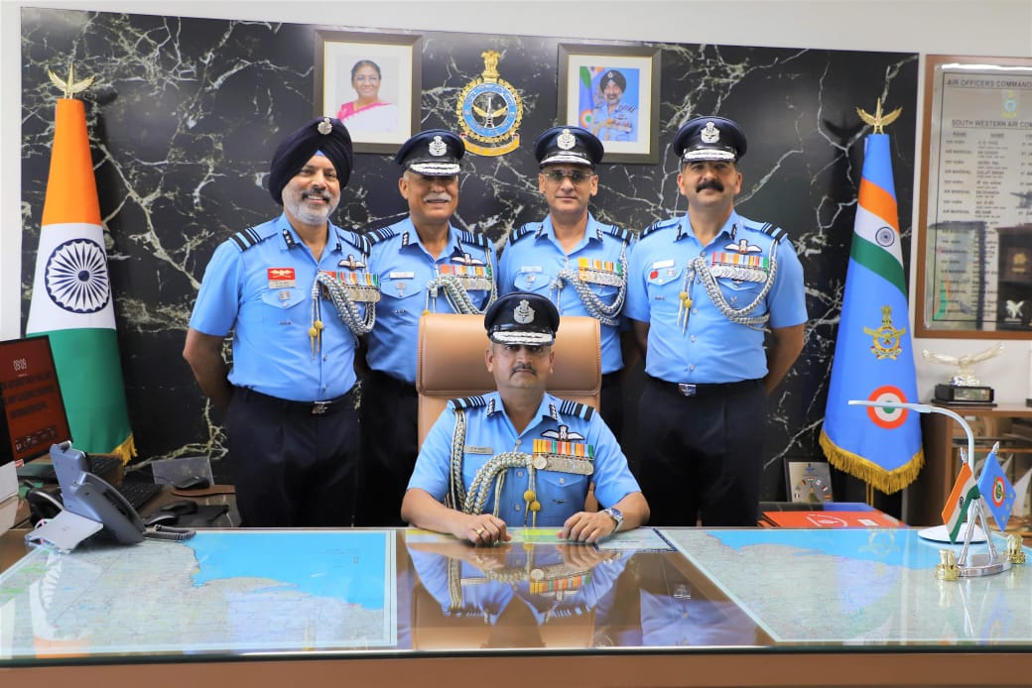
Major Defence Leadership Appointments
Air Marshal P.V. Shivanand, AVSM, VM assumed the appointment of Air Officer Commanding-in-Chief (AOC-in-C), South Western Air Command on 1 July 2026. After taking charge, he paid tribute to the Bravehearts at the South Western Air Command War Memorial.

Slide 11

Indian Army Creates Integrated Battle Groups in Major Military Reform
The Indian Army has initiated one of its most significant organisational reforms by raising five Integrated Battle Groups (IBGs) and one dedicated Fire Support Group (FSG).

Slide 12
Indian Army Creates Integrated Battle Groups in Major Military Reform
The move is aimed at transforming the Army into a faster, more agile, and technology-driven force capable of responding effectively to future security challenges. The new formations became operational on 1 July 2026 as part of the Army's ongoing modernisation programme.

Slide 13
Indian Army Creates Integrated Battle Groups in Major Military Reform
The first phase of the reform has been implemented under the XVII Mountain Strike Corps, headquartered at Panagarh in West Bengal. This corps is primarily responsible for operations along India's northern border with China.

Slide 14
Indian Army Creates Integrated Battle Groups in Major Military Reform
Unlike the traditional structure, where infantry, armour, artillery, engineers, air defence, signals, logistics, and aviation function separately, an IBG integrates these capabilities into a single formation.

Slide 15
Indian Army Creates Integrated Battle Groups in Major Military Reform
This enables rapid mobilisation, quicker decision-making, and enhanced operational flexibility across different terrains.

Slide 16
Indian Army Creates Integrated Battle Groups in Major Military Reform
Each IBG consists of more than 5,000 personnel and includes infantry, armoured units, artillery, engineers, air defence, signals, logistics, and surveillance assets.

Slide 17
Indian Army Creates Integrated Battle Groups in Major Military Reform
The formations are tailored according to the operational requirements of specific regions, making them suitable for both offensive and defensive operations.

Slide 18
Indian Army Creates Integrated Battle Groups in Major Military Reform
A newly introduced Chief Operations Officer, generally of Brigadier rank, will coordinate planning and execution within each IBG, ensuring greater synergy among different combat arms.

Slide 19
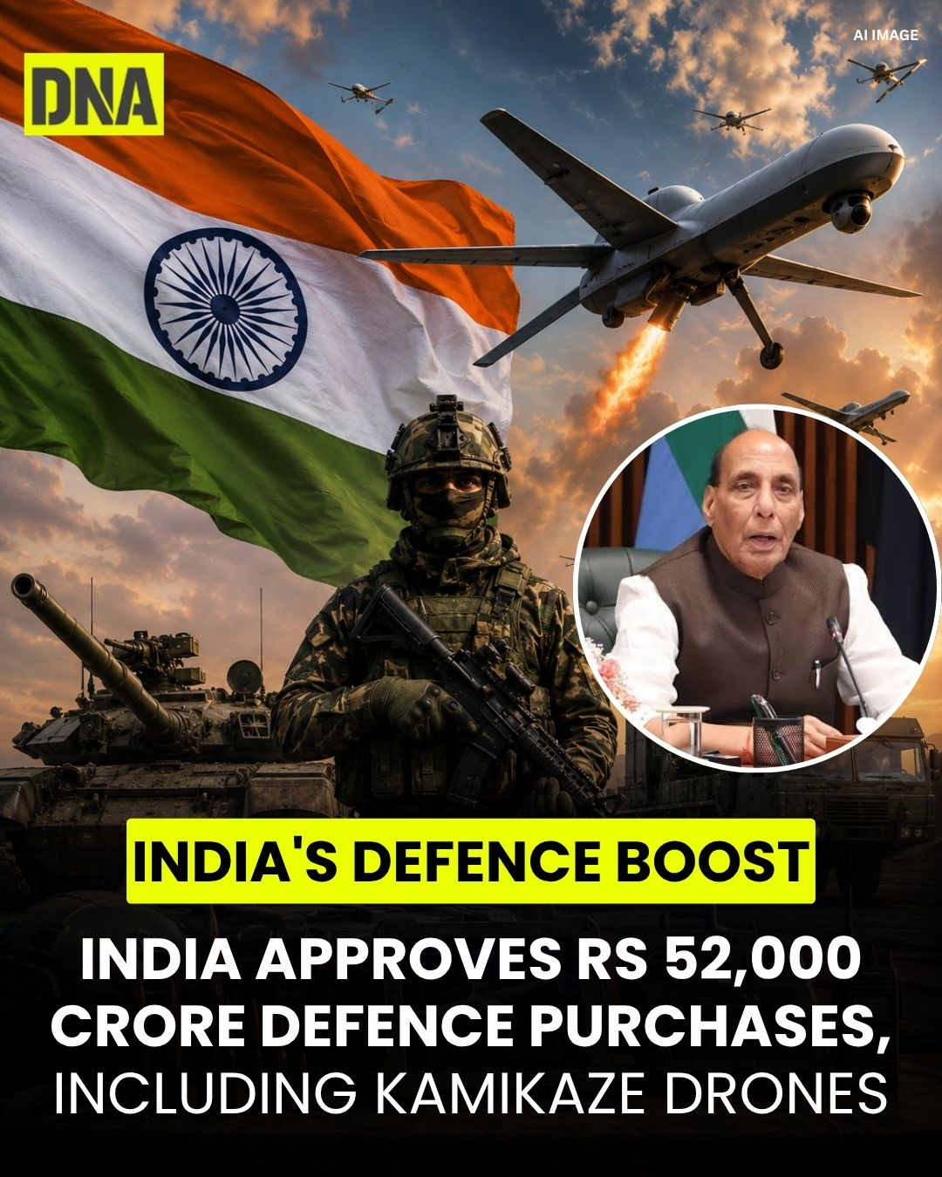
DAC Approves ₹52,000 Crore Defence Modernisation Plan
Defence Acquisition Council (DAC), chaired by Defence Minister Rajnath Singh, granted Acceptance of Necessity (AoN) for several high-value defence procurement projects on 3 July 2026. The approvals, valued at approximately ₹52,000 crore

Slide 20

What is Acceptance of Necessity (AoN)?
Acceptance of Necessity (AoN) is the first and most important stage in India's defence procurement process.

Slide 21
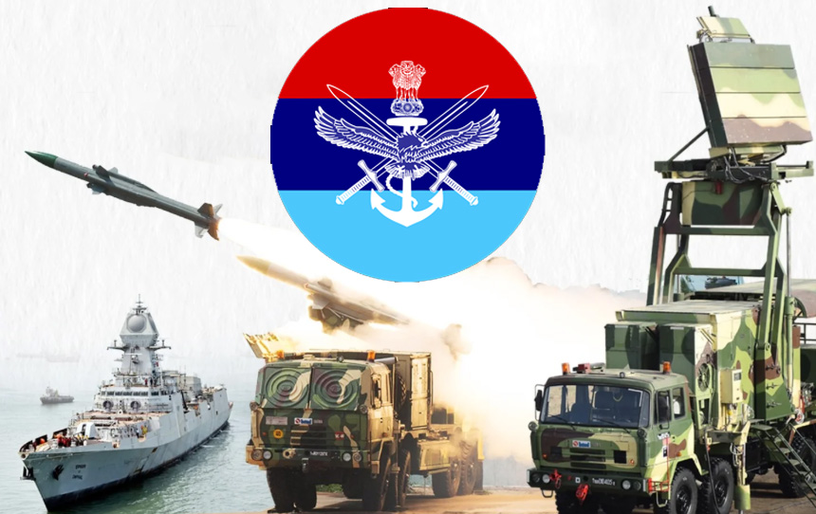
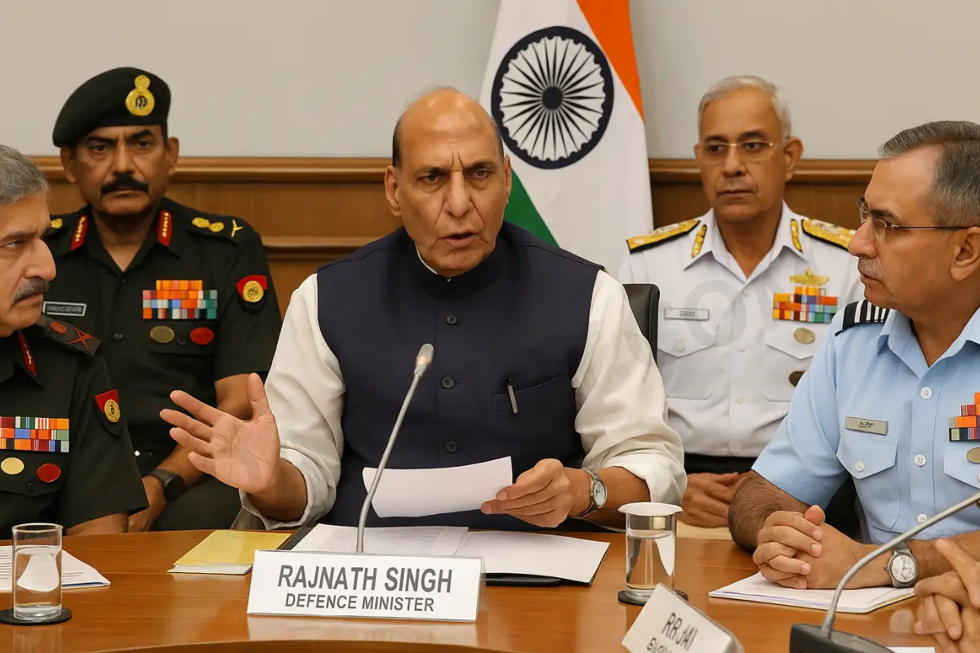
What is Acceptance of Necessity (AoN)?
It is an in-principle administrative approval granted by the Defence Acquisition Council for acquiring military equipment and weapon systems. Once AoN is approved, the concerned procurement agencies begin the detailed acquisition process, including tendering, evaluation, trials, and contract negotiations.

Slide 22
Major Approvals for the Indian Army
AKASH TARANG Anti-UAV Electronic Warfare System. The Army will procure the AKASH TARANG Anti-Unmanned Aerial Vehicle (UAV) Electronic Warfare System, developed to detect, track, jam, and neutralize hostile drones.

Slide 23
Major Approvals for the Indian Army
With the growing use of drones in modern warfare, this system will provide reliable protection to military formations and critical installations against aerial threats.

Slide 24
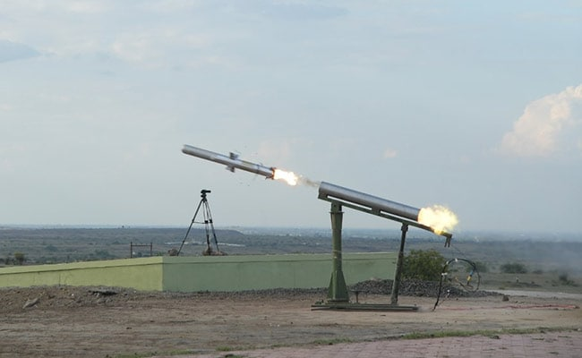
Major Defence Acquisition Proposals
The Defence Ministry is also likely to approve the induction of the Man-Portable Anti-Tank Guided Missile (MP-ATGM) developed by DRDO.

Slide 25
Major Defence Acquisition Proposals
Indigenous third-generation anti-tank missile.
Planned procurement includes around 100 launchers, 2,300 missiles, and five simulators.
The system will be manufactured by Bharat Dynamics Limited (BDL).
The project is estimated to cost over ₹2,600 crore.

Slide 26
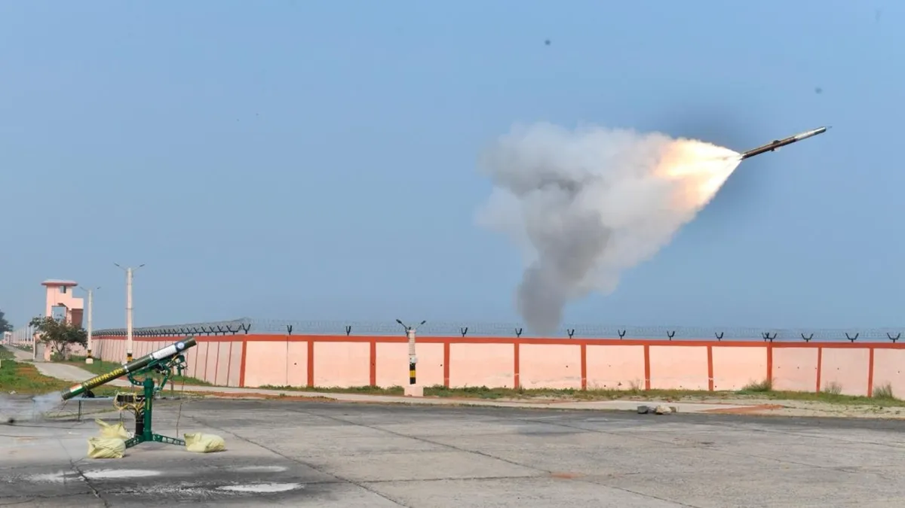
Major Defence Acquisition Proposals
The Army Air Defence Corps is expected to receive the Verba Very Short Range Air Defence System (V-SHORADS).

Slide 27
Major Defence Acquisition Proposals
Designed to intercept low-flying aircraft, helicopters, and drones.
Provides enhanced protection against aerial threats.
Intended to replace older-generation air defence systems currently in service.
Production in India is expected under the Make in India programme.

Slide 28
Major Defence Acquisition Proposals
Active Protection System (APS) for Tanks – Automatically detects and intercepts incoming anti-tank missiles and projectiles, improving tank survivability.
Jet-Based Kamikaze Drone System – High-speed loitering munition designed for precision strikes with enhanced electronic warfare capabilities.

Slide 29
For the Indian Navy
Multi Influence Ground Mine (MIGM) – Smart naval mine that restricts enemy warship movement using multiple detection mechanisms.
Naval Shipborne Unmanned Aerial System (NSUAS) – Ship-launched drone equipped with advanced sensors for surveillance and maritime reconnaissance.

Slide 30
For the Indian Navy
Land-Based Testing Facility (LBTF) for Electric Propulsion – Testing facility for validating electric propulsion systems for future naval platforms.

Slide 31

For the Indian Air Force
Another important proposal relates to the acquisition of fixed-wing High-Altitude Pseudo Satellites (HAPS).

Slide 32
For the Indian Air Force
Operate in the upper atmosphere for extended durations.
Provide continuous Intelligence, Surveillance and Reconnaissance (ISR).
Support secure communications and border monitoring.
Offer a cost-effective alternative to conventional satellites for persistent surveillance.

Slide 33
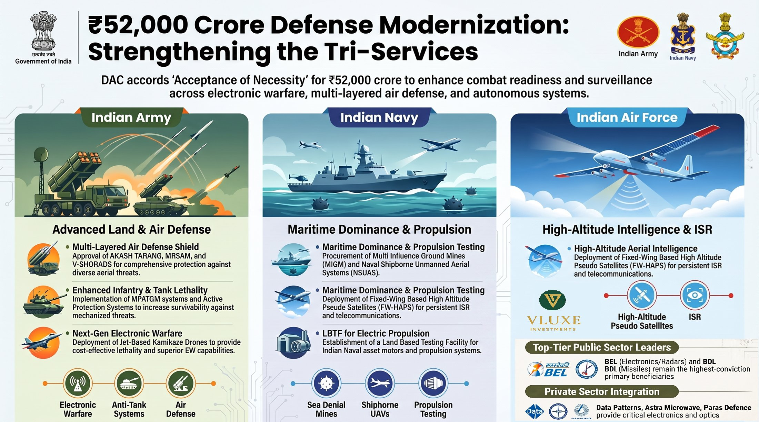

Slide 34
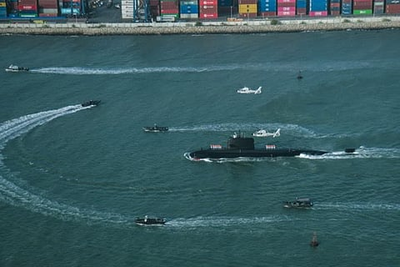
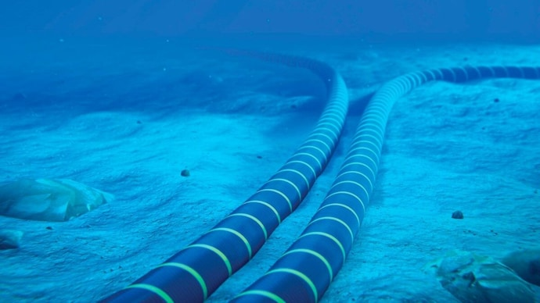
Undersea Cable Network for Submarine Detection
Bharat is moving to plant eyes and ears on the Indian Ocean seabed. DRDO has kicked off the hunt for an industry partner to develop and deploy an Underwater Fiber Optic Sensing System a fixed network of undersea sensors that will keep round-the-clock watch on submarines prowling India’s waters.

Slide 35
Undersea Cable Network for Submarine Detection
The Kochi-based Naval Physical and Oceanographic Laboratory (NPOL), DRDO’s premier underwater warfare lab, has floated an expression of interest (EOI) to identify a “lead system integrator” for the turnkey development, supply, transportation, deployment and commissioning of the system.

Slide 36
Undersea Cable Network for Submarine Detection
The network will comprise seabed sensor nodes linked by subsea fibre-optic cables to a shore station where the data will be received, monitored and analysed.

Slide 37

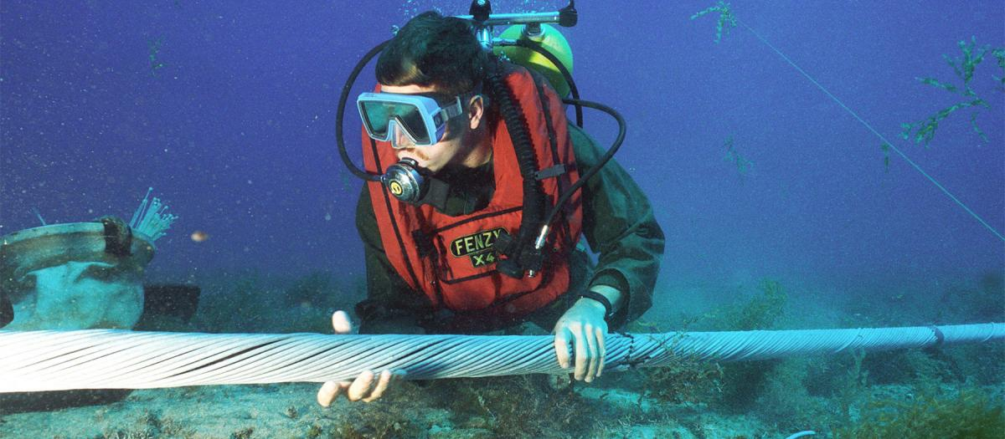
Undersea Cable Network for Submarine Detection
The move comes with the undersea battlespace in the Indian Ocean Region (IOR) getting increasingly contested.

Slide 38
Undersea Cable Network for Submarine Detection
Chinese nuclear and conventional submarines periodically prowl the IOR, while Chinese survey and “research” vessels systematically map the region’s waters, data invaluable for future submarine operations.

Slide 39
Undersea Cable Network for Submarine Detection
Pakistan, in turn, has also begun inducting eight Chinese-origin Hangor-class diesel-electric submarines with air-independent propulsion (AIP), the first of which has already been launched.

Slide 40
Undersea Cable Network for Submarine Detection
The concept has well-established precedents. During the Cold War, the United States deployed the Sound Surveillance System (SOSUS), a network of seabed-mounted hydrophone arrays connected by undersea cables to detect and track Soviet submarines.

Slide 41
Undersea Cable Network for Submarine Detection
The US and Japan later expanded similar underwater surveillance architecture across the western Pacific to monitor Chinese submarine movements, while China has built its own “underwater Great Wall” of seabed acoustic sensors in the South China Sea.

Slide 42

‘The Octagon’ – World’s Largest Military HQ
Egypt has officially inaugurated its new State Strategic Command Headquarters, popularly known as "The Octagon", marking a significant milestone in the country's military modernization programme.

Slide 43
‘The Octagon’ – World’s Largest Military HQ
Located in Egypt's New Administrative Capital, the massive defence complex is now regarded as the world's largest military headquarters by land area, surpassing the size of the Pentagon in the United States.

Slide 44
Why is it Called "The Octagon"?
The headquarters derives its name from its distinctive architectural design. The complex consists of eight interconnected octagonal buildings arranged around two central command structures.

Slide 45
Why is it Called "The Octagon"?
This layout symbolizes integrated military command while combining traditional Egyptian architectural elements with modern defence infrastructure.

Slide 46
Size and Scale
The Octagon covers nearly 22,000 acres, making it approximately 750 times larger than the Pentagon's main building footprint. It also provides more than 50 million square feet of built-up space and includes 13 strategic and logistical zones, making it one of the largest defence administrative complexes in the world.

Slide 47
Advanced Military Capabilities
The headquarters has been designed as a fully integrated command centre equipped with advanced Command, Control, Communications, Computers and Intelligence (C4I) systems along with Artificial Intelligence-enabled technologies. These capabilities are intended to improve:

Slide 48
Advanced Military Capabilities
Real-time operational coordination
Faster military decision-making
Secure communication across all armed forces
Intelligence sharing among defence agencies
Efficient crisis and emergency management

Slide 49
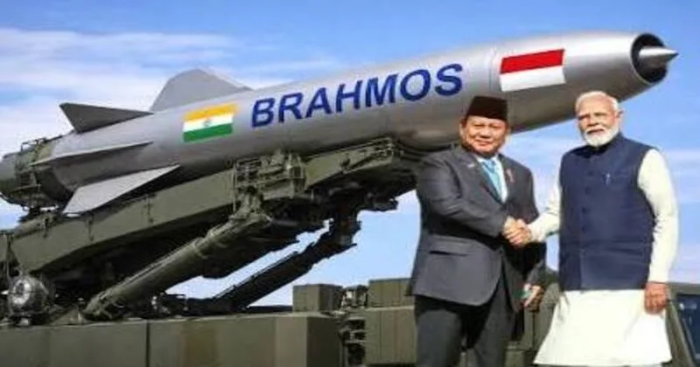
India And Indonesia Sign BrahMos And Astra Deal
Prime Minister Narendra Modi’s state visit to Indonesia has marked a significant milestone in bilateral relations, with the signing of more than eight agreements across defence, technology, health, education, and cultural cooperation.

Slide 50
India And Indonesia Sign BrahMos And Astra Deal
The centrepiece of these accords was the long-anticipated BrahMos missile deal, which firmly positions Indonesia as a key partner in India’s expanding coastal missile deployment network across Southeast Asia.

Slide 51
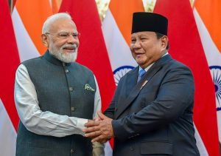
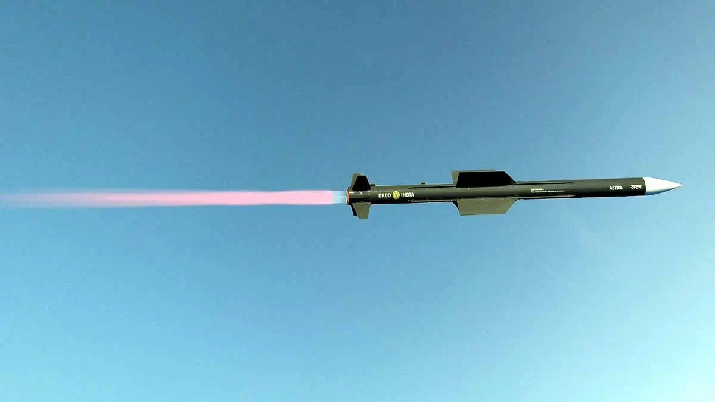
India And Indonesia Sign BrahMos And Astra Deal
Alongside this, India agreed to supply ASTRA air-to-air missile systems under a new arrangement between Bharat Dynamics and Indonesia’s Republic Corps, further strengthening defence interoperability.

Slide 52
India And Indonesia Sign BrahMos And Astra Deal
The agreements extended well beyond defence. A framework on maritime safety and security was finalised, reflecting the shared priority of safeguarding sea lanes in the Indo-Pacific.

Slide 53
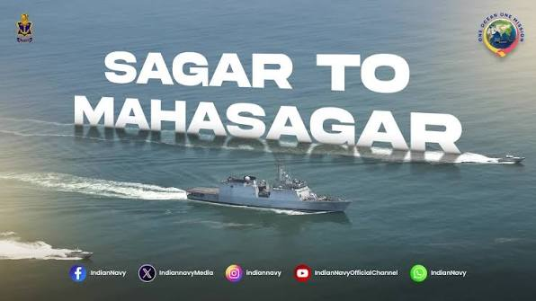
India And Indonesia Sign BrahMos And Astra Deal
The ongoing multi-nation tour, which includes Australia and New Zealand, is firmly aligned with India’s Act East Policy and the MAHASAGAR Vision, reinforcing New Delhi’s commitment to a free and open Indo-Pacific.

Slide 54
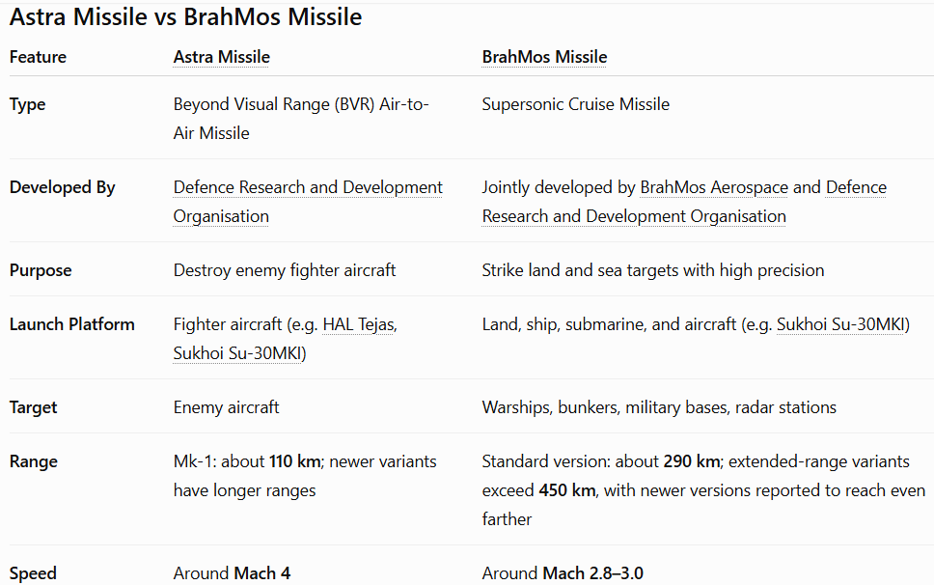

Slide 55

Ugram Indigenous Assault Rifle Clears Army Trials
The Ugram is an indigenous 7.62×51mm assault rifle developed in India by the Armament Research and Development Establishment, a laboratory of the DRDO and Dvipa Defence India Private Limited.

Slide 56
Ugram Indigenous Assault Rifle Clears Army Trials
It cleared the Indian Army’s General Staff Qualitative Requirement trials and the Ministry of Home Affairs Board trials in July 2026.

Slide 57
Ugram Indigenous Assault Rifle Clears Army Trials
The rifle is expected to be procured by Central Armed Police Forces in India. These include the Central Reserve Police Force, Indo-Tibetan Border Police, Sashastra Seema Bal, and National Security Guard.

Slide 58
Ugram Indigenous Assault Rifle Clears Army Trials
The General Staff Qualitative Requirement, or GSQR, is the technical and operational standard used by the Indian Army for equipment trials.
The Ministry of Home Affairs oversees several Central Armed Police Forces, including the CRPF, ITBP, SSB, and NSG.

Slide 59
Ugram Indigenous Assault Rifle Clears Army Trials
The INSAS rifle is a 5.56mm service rifle that has been used by Indian security forces since the 1990s.
Atmanirbhar Bharat is a Government of India initiative linked with domestic manufacturing and reduced import dependence.

Slide 60
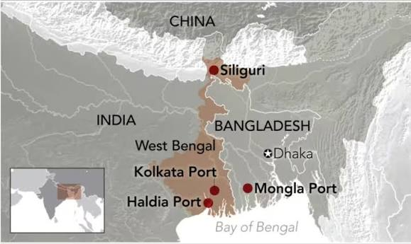

Bangladesh Replaces India And Hands Over Mongla Port Project To China
Bangladesh’s decision to replace India with China in the Mongla Port project marks a major strategic setback for New Delhi, as the Bay of Bengal increasingly becomes a contested arena in the India‑China rivalry.

Slide 61
Bangladesh Replaces India And Hands Over Mongla Port Project To China
Mongla’s proximity to India’s border and its role in regional trade corridors make it a critical node in South Asia’s maritime geopolitics.

Slide 62
Bangladesh Replaces India And Hands Over Mongla Port Project To China
Bangladesh has formally signed an agreement with China Civil Engineering Construction Corporation to develop the Mongla Port Economic Zone.

Slide 63
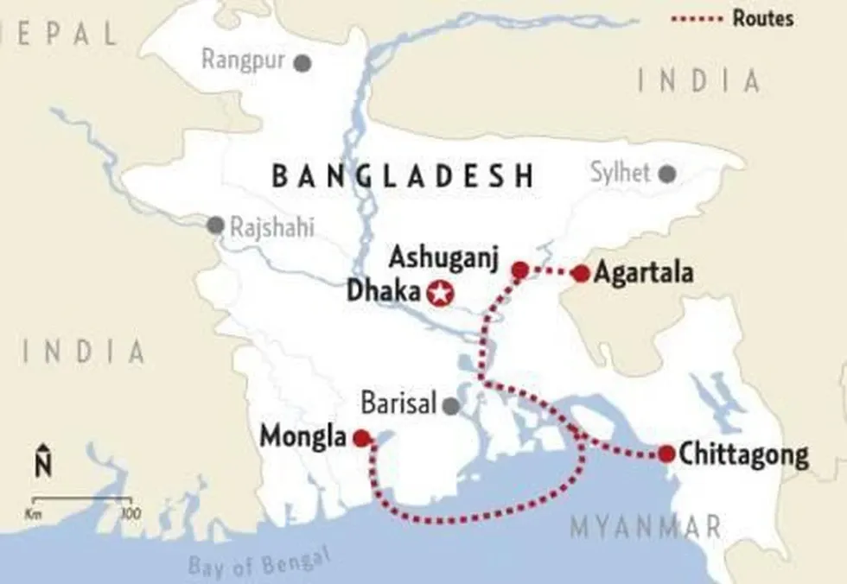
Bangladesh Replaces India And Hands Over Mongla Port Project To China
This project was originally reserved for India under a 2015 bilateral initiative, but delays and failure to begin construction led Dhaka to delist the Indian plan in 2025. China quickly stepped in, securing the deal during PM Tarique Rahman’s first state visit to Beijing.

Slide 64
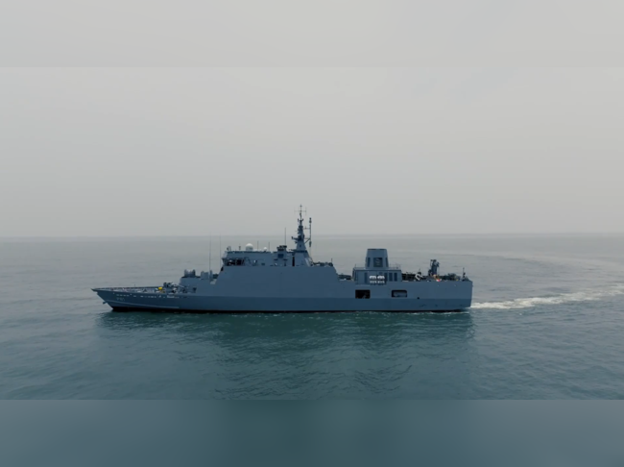
INS Malvan: Indian Navy Inducts Submarine Hunter
The Indian Navy has further strengthened its maritime security capabilities with the induction of INS Malvan, the second Mahe-class Anti-Submarine Warfare Shallow Water Craft (ASW-SWC).

Slide 65
INS Malvan: Indian Navy Inducts Submarine Hunter
Commissioned on 22 July 2026, the warship has been designed specifically to detect, track, and counter enemy submarines operating in India's coastal waters.

Slide 66
INS Malvan: Indian Navy Inducts Submarine Hunter
The induction of INS Malvan comes at a time when underwater activity in the Indian Ocean Region (IOR) is increasing, making anti-submarine warfare one of the Indian Navy's highest operational priorities.

Slide 67
INS Malvan: Indian Navy Inducts Submarine Hunter
The vessel also reflects India's growing emphasis on Aatmanirbhar Bharat through indigenous warship design and construction.

Slide 68
INS Malvan: Indian Navy Inducts Submarine Hunter
To enhance coastal defence, the Indian Navy launched the Anti-Submarine Warfare Shallow Water Craft (ASW-SWC) Programme, under which 16 indigenous vessels are being built.

Slide 69
INS Malvan: Indian Navy Inducts Submarine Hunter
These ships are intended to operate alongside larger destroyers, frigates, maritime patrol aircraft, and submarines, creating a multi-layered anti-submarine defence network. INS Malvan is the second vessel of this new generation of submarine hunters.

Slide 70

Captain Shivani Becomes First-Ever Woman Aide-de-Camp to Chief of Army Staff
Captain Shivani has created history by becoming the first-ever woman officer to be appointed as the Aide-de-Camp (ADC) to the Chief of the Army Staff (COAS), General Dhiraj Seth.

Slide 71
Captain Shivani Becomes First-Ever Woman Aide-de-Camp to Chief of Army Staff
Her appointment marks a significant milestone in the Indian Army’s evolving journey towards greater inclusion and expanding leadership opportunities for women officers, while reaffirming the institution’s enduring emphasis on merit, excellence and professionalism.

Slide 72
Captain Shivani Becomes First-Ever Woman Aide-de-Camp to Chief of Army Staff
The prestigious appointment places Captain Shivani among a select group of officers entrusted with one of the most distinguished responsibilities in military service.

Slide 73
Captain Shivani Becomes First-Ever Woman Aide-de-Camp to Chief of Army Staff
The Indian Army’s approach towards expanding opportunities for women officers has consistently been guided by the principles of merit, capability and professional excellence.

Slide 74
Captain Shivani Becomes First-Ever Woman Aide-de-Camp to Chief of Army Staff
Captain Shivani’s selection for this prestigious assignment exemplifies this institutional commitment and reinforces the Army’s emphasis on recognising talent and dedication irrespective of gender.

Slide 75
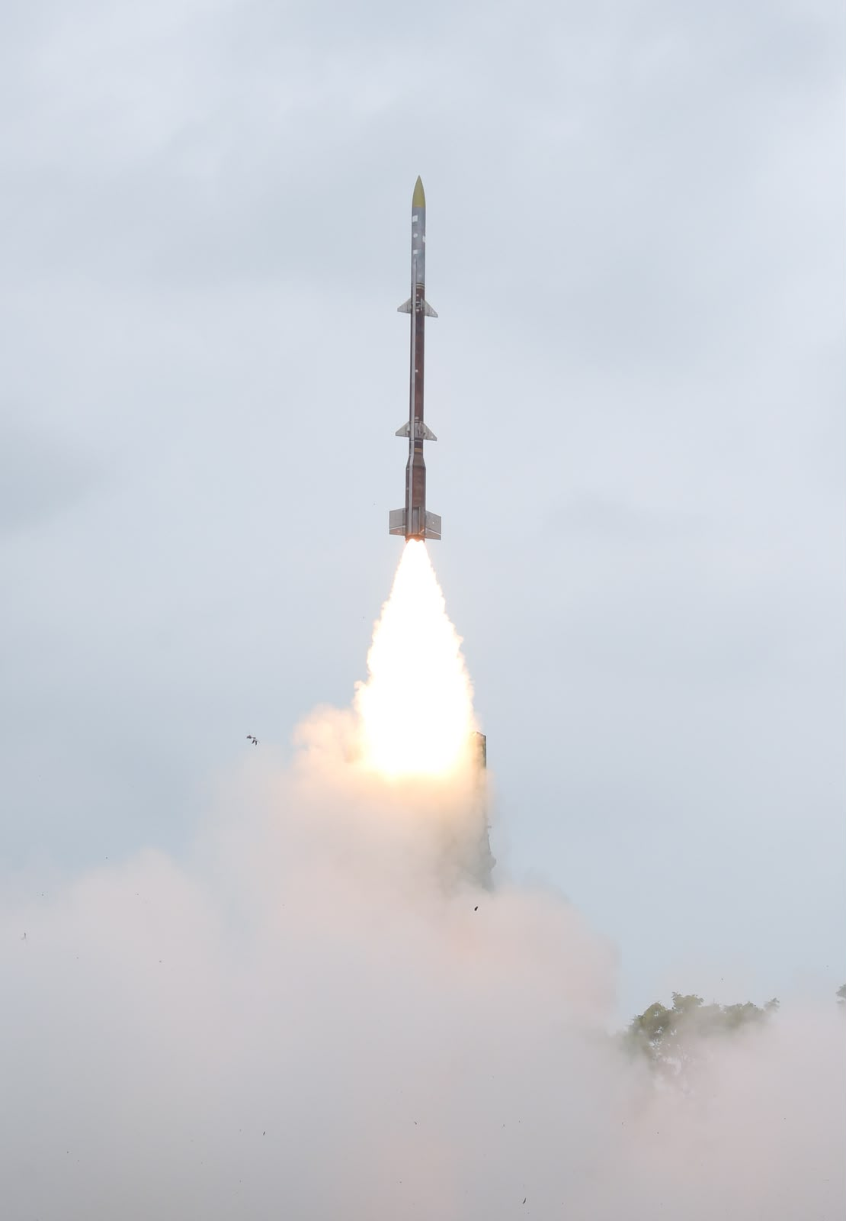
DRDO Conducts Successful Maiden Flight-test of ‘Kusha’
DRDO successfully conducted the maiden flight-test of ‘Kusha’ Long-Range Surface-to-Air Missile from the APJ Abdul Kalam Island off the coast of Odisha on July 23, 2026.

Slide 76
DRDO Conducts Successful Maiden Flight-test of ‘Kusha’
This maiden test was conducted against an electronic target simulating high-speed and high-altitude aerial threat which was successfully intercepted by the missile system.

Slide 77
DRDO Conducts Successful Maiden Flight-test of ‘Kusha’
The ‘Kusha’ missile system is capable of neutralising a wide variety of aerial threats including fighter jets, missiles, unmanned aerial vehicles and large enemy aircraft within a wide range & altitude envelope.

Slide 78
DRDO Conducts Successful Maiden Flight-test of ‘Kusha’
All weapon system elements, including the missiles, radars, command and control centre, have been developed by various DRDO laboratories and Industry partners.

Slide 79
DRDO Conducts Successful Maiden Flight-test of ‘Kusha’
Raksha Mantri Shri Rajnath Singh stated that the successful test-flight of ‘Kusha’ marks an important milestone in Indian defence R&D, highlighting the capability in developing long range surface-to-air missile system, possessed only by a handful of nations.

Slide 80
DRDO Conducts Successful Maiden Flight-test of ‘Kusha’
This, he added, will also eliminate the import dependency for such systems and signifies a giant leap in air defence capability of the nation.

Slide 81
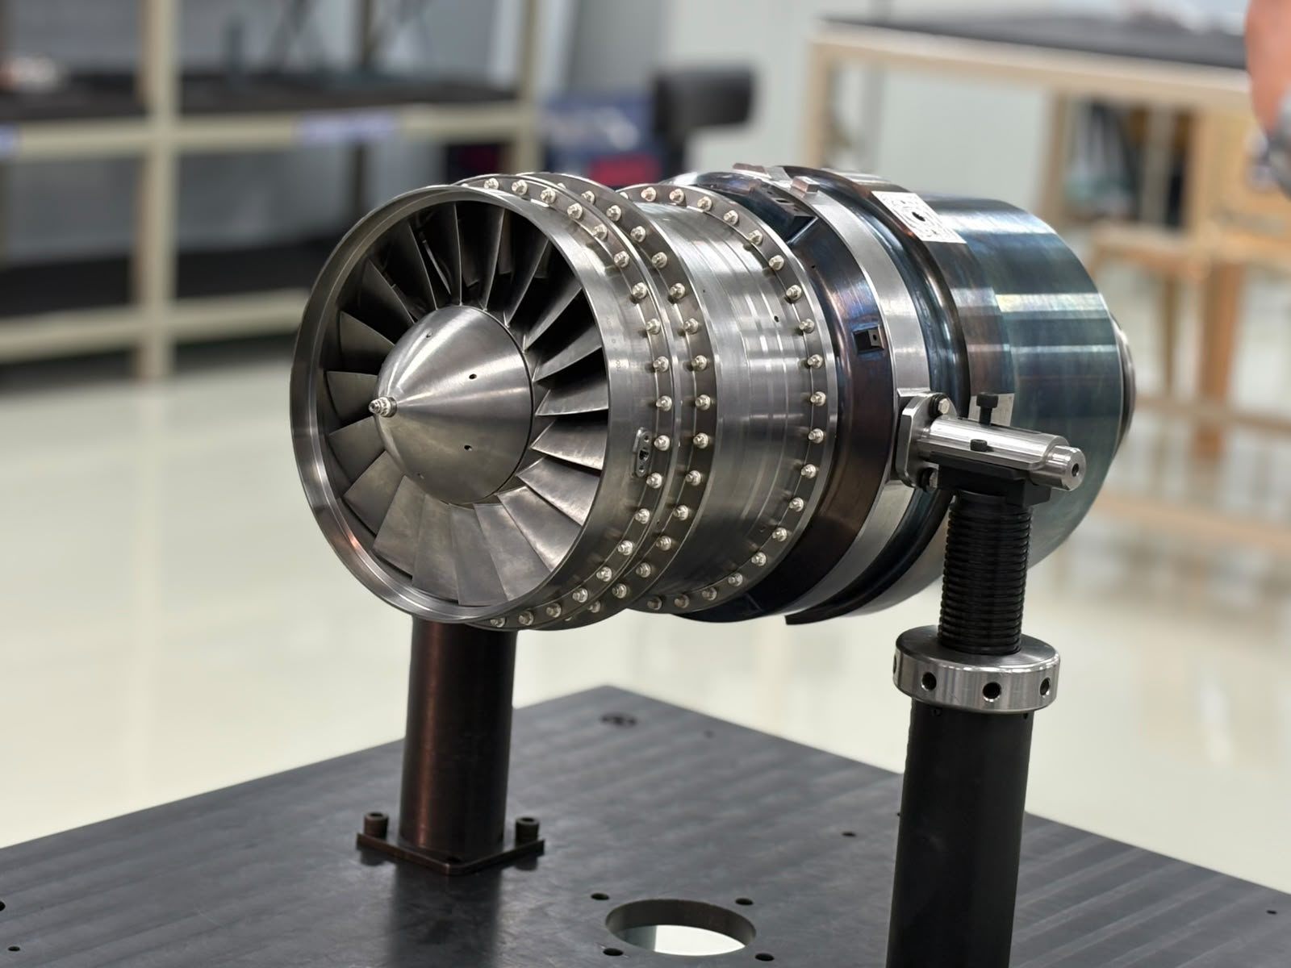
Successful Development of First Indigenous Expendable Turbo Jet Engine
The first indigenous Expendable Turbo Jet Engine of 350 kg thrust class, designed by DRDO’s Gas Turbine Research Establishment (GTRE), has been successfully developed. GTRE had identified Azad Engineering, Hyderabad as Industry partner for the manufacturing and assembly of the engine.

Slide 82
Successful Development of First Indigenous Expendable Turbo Jet Engine
On July 22, 2026, the engine was successfully realised and delivered to GTRE by Azad Engineering, a landmark achievement for India's aerospace and defence ecosystem.

Slide 83
Successful Development of First Indigenous Expendable Turbo Jet Engine
The delivery marks the culmination of years of precision engineering, advanced manufacturing, and close partnership between India's scientific & industrial communities.

Slide 84
Successful Development of First Indigenous Expendable Turbo Jet Engine
Mastered by only a handful of nations, jet engine technology is widely regarded as one of the most sophisticated engineering disciplines in the world, demanding exceptional precision, advanced metallurgy, and uncompromising manufacturing standards.

Slide 85
Successful Development of First Indigenous Expendable Turbo Jet Engine
Delivery of such complex system based on the design of DRDO reflects the growing technological capabilities of the Indian Defence Industry.

Slide 86


India Targets Five Small Modular Reactors By 2033
India has accelerated its nuclear ambitions, confirming plans to commission at least five indigenous small modular reactors (SMRs) by 2033, with Tarapur in Maharashtra designated as the first site.

Slide 87
India Targets Five Small Modular Reactors By 2033
The initiative is backed by a ₹20,000 crore allocation under the Nuclear Energy Mission and aims to expand nuclear capacity to 100 GW by 2047, reducing reliance on fossil fuels.

Slide 88
India Targets Five Small Modular Reactors By 2033
India has formally advanced its program for small modular reactors, targeting the commissioning of five units by 2033. The Bhabha Atomic Research Centre is leading the development of three designs: the 220 MW Bharat Small Modular Reactor, a 55 MW reactor, and a high‑temperature gas‑cooled reactor intended for hydrogen production.

Slide 89
India Targets Five Small Modular Reactors By 2033
These projects have received in‑principle approval from the Atomic Energy Commission, with Tarapur in Maharashtra selected as the site for both the 220 MW and 55 MW reactors.

Slide 90
India Targets Five Small Modular Reactors By 2033
The government has set ambitious nuclear expansion goals, aiming to raise installed capacity from the current 8.8 GW to 22 GW by 2031‑32. By 2047, the target is 100 GW, with small modular reactors expected to play a crucial role in this trajectory.

Slide 91
India Targets Five Small Modular Reactors By 2033
The Nuclear Power Corporation of India Limited, the country’s sole nuclear operator, plans to contribute 50 GW, while NTPC, India’s largest coal‑based power producer, is preparing to add 30 GW of nuclear capacity.

Slide 92
India Targets Five Small Modular Reactors By 2033
Globally, small modular reactors are being pursued by countries including the United States, Russia, and South Korea.

Slide 93

Indian Navy Sailors Have Become The First-ever Indian Women Épée Fencers
Taniksha Khatri and Prachi Lohan etched their names into Indian fencing history by becoming the first Indian women’s épée fencers to qualify for the Main Table of 64 at the Senior World Fencing Championships, marking a breakthrough moment for the sport on the opening day of the 2026 edition at the Asia World-Expo in Hong Kong.

Slide 94

Indian Navy Sailors Have Become The First-ever Indian Women Épée Fencers
Competing in the qualification rounds of the Women’s Individual Épée event, the two Indians progressed through a highly competitive field after negotiating the round-robin pool stage and preliminary direct elimination bouts to secure places in the main draw.

Slide 95

Indian Navy Sailors Have Become The First-ever Indian Women Épée Fencers
Their achievement marks the first time Indian women épée fencers have reached the Main Table of 64 at the prestigious global championship.

Slide 96
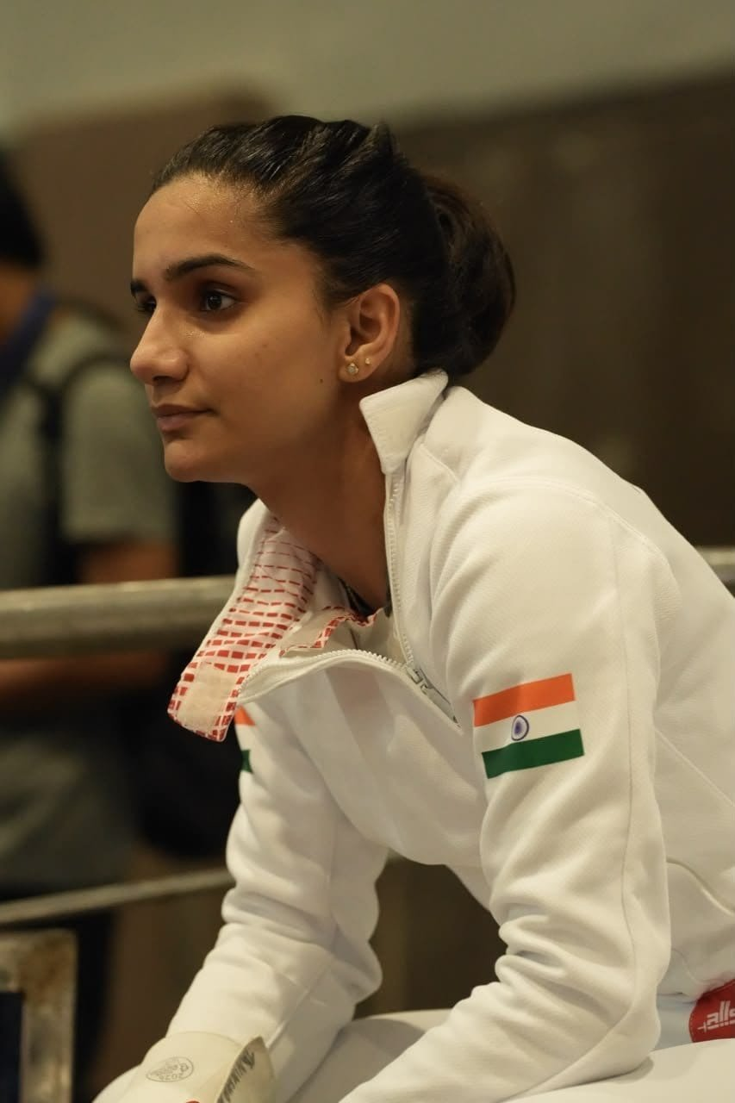
Indian Navy Sailors Have Become The First-ever Indian Women Épée Fencers
The nine-day competition has brought together more than 1,000 fencers from over 100 countries. India has fielded a 24-member contingent comprising 12 men and 12 women across foil, épée and sabre disciplines.

Slide 98
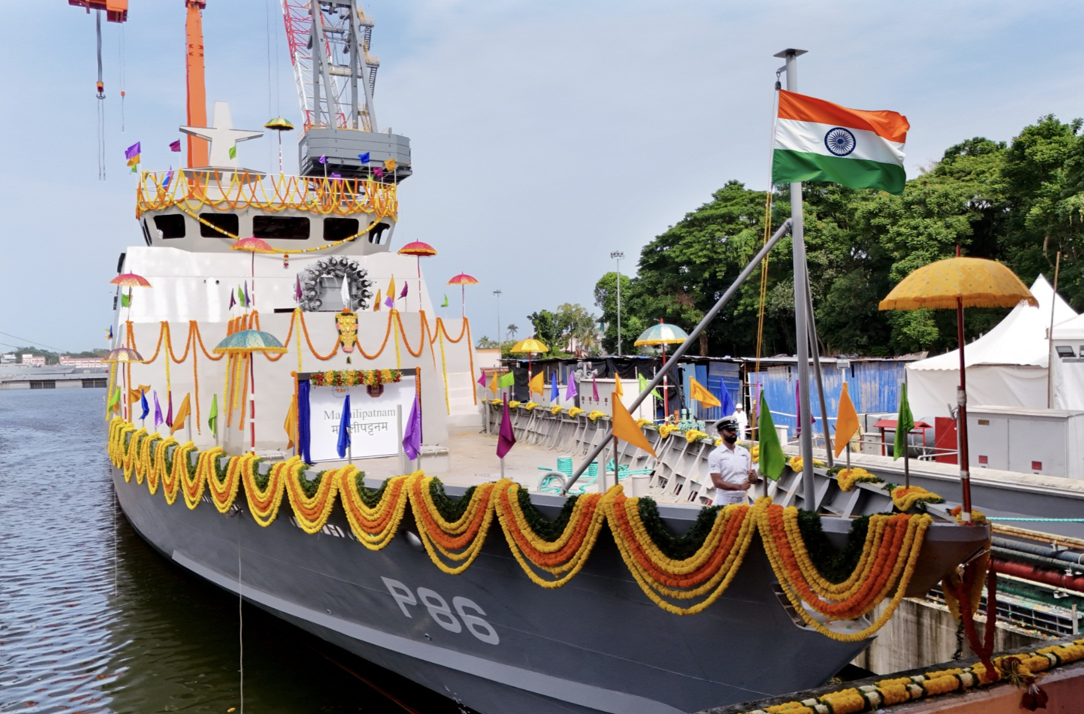
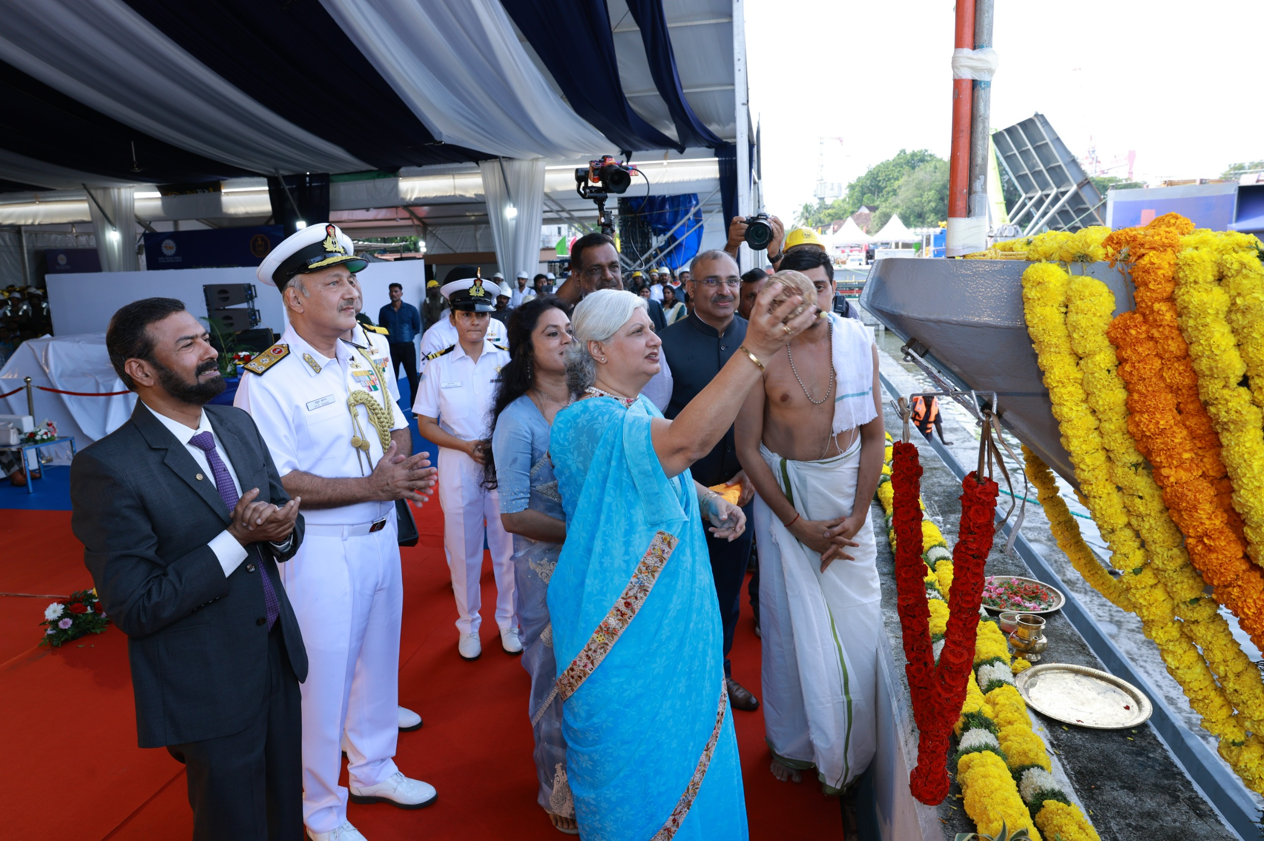
Launch of Machilipatnam
Machilipatnam (BY 529), the seventh of eight Anti-Submarine Warfare Shallow Water Craft (ASW SWC), being built by Cochin Shipyard Limited (CSL) for the Indian Navy, was launched on 29 Jul 2026.

Slide 99
Launch of Machilipatnam
Machilipatnam carries deep historical and cultural significance as it derives its name from the historic port city of Machilipatnam, in Krishna district of Andhra Pradesh, known for its rich maritime legacy and flourishing trade along India's eastern seaboard.

Slide 100
Launch of Machilipatnam
The ship proudly embodies the spirit and legacy of Machilipatnam while reinforcing the Indian Navy's commitment to safeguarding the nation's maritime interests.

Slide 101
Launch of Machilipatnam
The ship is equipped for Underwater Surveillance, Anti-Submarine Warfare (ASW) operations, and Low Intensity Maritime Operations (LIMO), along with Mine Warfare capability.

Slide 102
Launch of Machilipatnam
The launch of Machilipatnam marks another milestone in the successful execution of the ASW SWC project and reaffirms India's commitment to Aatmanirbhar Bharat in defence manufacturing.

Slide 103
Launch of Machilipatnam
With indigenous content exceeding 80 percent, the project showcases the growing capability of the Indian shipbuilding industry and will substantially enhance the Indian Navy's operational readiness for safeguarding the nation's maritime interests in the Indian Ocean Region.

Slide 104



Slide 105


Slide 106


Slide 107


Slide 108

REVIEW QUESTIONS

Slide 109
Who assumed the appointment of the Vice Chief of the Army Staff (VCOAS) on 1 July 2026?
Lt Gen Rajesh Pushkar
Lt Gen Mohit Malhotra
Lt Gen Sandeep Jain
Gen Dhiraj Seth

Slide 110
Who assumed the appointment of the Vice Chief of the Army Staff (VCOAS) on 1 July 2026?
Lt Gen Rajesh Pushkar
Lt Gen Mohit Malhotra
Lt Gen Sandeep Jain
Gen Dhiraj Seth

Slide 111
Who assumed charge as the GOC-in-C of the Southern Command on 1 July 2026?
Lt Gen Mohit Malhotra
Lt Gen Dhiraj Seth
Lt Gen Rajesh Pushkar
Lt Gen Upendra Dwivedi

Slide 112
Who assumed charge as the GOC-in-C of the Southern Command on 1 July 2026?
Lt Gen Mohit Malhotra
Lt Gen Dhiraj Seth
Lt Gen Rajesh Pushkar
Lt Gen Upendra Dwivedi

Slide 113
Lieutenant General Mohit Malhotra assumed command of which Army Command?
Northern Command
Eastern Command
Southern Command
South Western Command

Slide 114
Lieutenant General Mohit Malhotra assumed command of which Army Command?
Northern Command
Eastern Command
Southern Command
South Western Command

Slide 115
Air Marshal P.V. Shivanand assumed the appointment of Air Officer Commanding-in-Chief (AOC-in-C) of the:
Western Air Command
Eastern Air Command
Central Air Command
South Western Air Command

Slide 116
Air Marshal P.V. Shivanand assumed the appointment of Air Officer Commanding-in-Chief (AOC-in-C) of the:
Western Air Command
Eastern Air Command
Central Air Command
South Western Air Command

Slide 117
The Octagon, recently seen in the news, is the new military headquarters of which country?
Saudi Arabia
Türkiye
Egypt
United Arab Emirates

Slide 118
The Octagon, recently seen in the news, is the new military headquarters of which country?
Saudi Arabia
Türkiye
Egypt
United Arab Emirates

Slide 119
INS Mahendragiri (F38) belongs to which class of warships?
Project 15B Destroyer
Project 17A Stealth Frigate
Project 75 Submarine
Nilgiri-class Corvette

Slide 120
INS Mahendragiri (F38) belongs to which class of warships?
Project 15B Destroyer
Project 17A Stealth Frigate
Project 75 Submarine
Nilgiri-class Corvette

Slide 121
INS Mahendragiri has been named after which geographical feature of India?
Aravalli Hills
Vindhya Range
Mahendragiri Mountain Range in the Eastern Ghats
Satpura Hills

Slide 122
INS Mahendragiri has been named after which geographical feature of India?
Aravalli Hills
Vindhya Range
Mahendragiri Mountain Range in the Eastern Ghats
Satpura Hills

Slide 123
Which organization designed INS Mahendragiri, and which shipyard built it?
DRDO and Cochin Shipyard Limited
Warship Design Bureau (Indian Navy) and Mazagon Dock Shipbuilders Limited
HAL and Garden Reach Shipbuilders & Engineers
Bharat Electronics Limited and Goa Shipyard Limited

Slide 124
Which organization designed INS Mahendragiri, and which shipyard built it?
DRDO and Cochin Shipyard Limited
Warship Design Bureau (Indian Navy) and Mazagon Dock Shipbuilders Limited
HAL and Garden Reach Shipbuilders & Engineers
Bharat Electronics Limited and Goa Shipyard Limited

Slide 125
The Astra missile is primarily classified as a:
Ballistic Missile
Cruise Missile
Surface-to-Air Missile
Beyond Visual Range Air-to-Air Missile (BVRAAM)

Slide 126
The Astra missile is primarily classified as a:
Ballistic Missile
Cruise Missile
Surface-to-Air Missile
Beyond Visual Range Air-to-Air Missile (BVRAAM)

Slide 127
India and France launched their first Joint Working Group (JWG) on which strategic sector?
Artificial Intelligence
Space Technology
Nuclear Energy
Critical Minerals

Slide 128
India and France launched their first Joint Working Group (JWG) on which strategic sector?
Artificial Intelligence
Space Technology
Nuclear Energy
Critical Minerals

Slide 129
Which of the following is NOT generally considered a critical mineral?
Lithium
Cobalt
Graphite
Limestone

Slide 130
Which of the following is NOT generally considered a critical mineral?
Lithium
Cobalt
Graphite
Limestone

Slide 131
Ugram assault rifle has been jointly developed by DRDO's ARDE and which private company?
Tata Advanced Systems
Bharat Forge
Adani Defence
Dvipa Defence India Private Limited

Slide 132
Ugram assault rifle has been jointly developed by DRDO's ARDE and which private company?
Tata Advanced Systems
Bharat Forge
Adani Defence
Dvipa Defence India Private Limited

Slide 133
The Ugram assault rifle uses which calibre ammunition?
5.56 × 45 mm
7.62 × 39 mm
7.62 × 51 mm
9 × 19 mm

Slide 134
The Ugram assault rifle uses which calibre ammunition?
5.56 × 45 mm
7.62 × 39 mm
7.62 × 51 mm
9 × 19 mm

Slide 135
India and New Zealand have set a target to increase their bilateral trade in goods and services to what amount by 2030?
NZ$5 billion
NZ$6 billion
NZ$7 billion
NZ$10 billion

Slide 136
India and New Zealand have set a target to increase their bilateral trade in goods and services to what amount by 2030?
NZ$5 billion
NZ$6 billion
NZ$7 billion
NZ$10 billion

Slide 137
Which international alliance mentioned in the Roadmap focuses on promoting solar energy deployment and clean energy cooperation?
International Energy Agency (IEA)
Global Green Growth Institute (GGGI)
International Solar Alliance (ISA)
International Renewable Energy Agency (IRENA)

Slide 138
Which international alliance mentioned in the Roadmap focuses on promoting solar energy deployment and clean energy cooperation?
International Energy Agency (IEA)
Global Green Growth Institute (GGGI)
International Solar Alliance (ISA)
International Renewable Energy Agency (IRENA)

Slide 139
The Bureau of Port Security (BoPS) will function under which ministry?
Ministry of Home Affairs
Ministry of Defence
Ministry of Fisheries, Animal Husbandry and Dairying
Ministry of Ports, Shipping and Waterways

Slide 140
The Bureau of Port Security (BoPS) will function under which ministry?
Ministry of Home Affairs
Ministry of Defence
Ministry of Fisheries, Animal Husbandry and Dairying
Ministry of Ports, Shipping and Waterways

Slide 141
What is the name of India's humanitarian relief mission launched to assist Venezuela after the devastating earthquake?
Operation Maitri
Operation Sahayata
Operation Karuna
Operation Amistad

Slide 142
What is the name of India's humanitarian relief mission launched to assist Venezuela after the devastating earthquake?
Operation Maitri
Operation Sahayata
Operation Karuna
Operation Amistad

Slide 143
INS Malvan, inducted into the Indian Navy in July 2026, belongs to which class of warships?
Project 17A Stealth Frigate
Nilgiri-class Frigate
Mahe-class Anti-Submarine Warfare Shallow Water Craft (ASW-SWC)
Kamorta-class Corvette

Slide 144
INS Malvan, inducted into the Indian Navy in July 2026, belongs to which class of warships?
Project 17A Stealth Frigate
Nilgiri-class Frigate
Mahe-class Anti-Submarine Warfare Shallow Water Craft (ASW-SWC)
Kamorta-class Corvette

Slide 145
Which of the following statements about INS Malvan is correct?
1. It has been built by Cochin Shipyard Limited (CSL), Kochi.
2. It is designed primarily for Anti-Submarine Warfare (ASW) operations in shallow coastal waters. 3. It is powered by nuclear propulsion.
Select the correct answer using the code below:
1 and 2 only
2 and 3 only
1 and 3 only
1, 2 and 3

Slide 146
Which of the following statements about INS Malvan is correct?
1. It has been built by Cochin Shipyard Limited (CSL), Kochi.
2. It is designed primarily for Anti-Submarine Warfare (ASW) operations in shallow coastal waters. 3. It is powered by nuclear propulsion.
Select the correct answer using the code below:
1 and 2 only
2 and 3 only
1 and 3 only
1, 2 and 3

Slide 147
The maiden flight-test of the 'Kusha' Long-Range Surface-to-Air Missile was conducted by:
ISRO
HAL
DRDO
BEL

Slide 148
The maiden flight-test of the 'Kusha' Long-Range Surface-to-Air Missile was conducted by:
ISRO
HAL
DRDO
BEL

Slide 149
India's first indigenous Expendable Turbo Jet Engine has been designed by:
ADA
HAL
Gas Turbine Research Establishment (GTRE), DRDO
BHEL

Slide 150
India's first indigenous Expendable Turbo Jet Engine has been designed by:
ADA
HAL
Gas Turbine Research Establishment (GTRE), DRDO
BHEL

Slide 151
The Netro NW-3000 supplied by MKU Limited is a:
Radar System
Assault Rifle
Thermal Drone
Night-Vision Weapon Sight

Slide 152
The Netro NW-3000 supplied by MKU Limited is a:
Radar System
Assault Rifle
Thermal Drone
Night-Vision Weapon Sight

Slide 153
Machilipatnam (BY 529), launched by the Indian Navy, is the:
Fifth Survey Vessel (Large)
Sixth Missile Corvette
Seventh Anti-Submarine Warfare Shallow Water Craft (ASW SWC)
Eighth Offshore Patrol Vessel

Slide 154
Machilipatnam (BY 529), launched by the Indian Navy, is the:
Fifth Survey Vessel (Large)
Sixth Missile Corvette
Seventh Anti-Submarine Warfare Shallow Water Craft (ASW SWC)
Eighth Offshore Patrol Vessel

Slide 155
Machilipatnam (BY 529) has been constructed by:
Mazagon Dock Shipbuilders Limited (MDL)
Garden Reach Shipbuilders & Engineers (GRSE)
Goa Shipyard Limited (GSL)
Cochin Shipyard Limited (CSL)

Slide 156
Machilipatnam (BY 529) has been constructed by:
Mazagon Dock Shipbuilders Limited (MDL)
Garden Reach Shipbuilders & Engineers (GRSE)
Goa Shipyard Limited (GSL)
Cochin Shipyard Limited (CSL)

Slide 157
QUESTION OF THE DAY

Slide 158
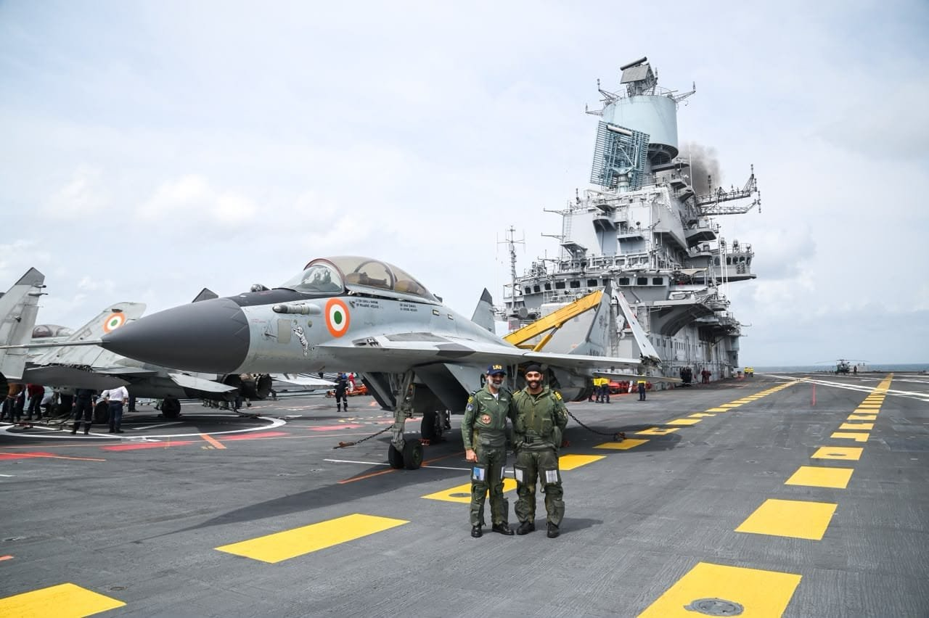
Identify The Aircraft and Aircraft Carrier

Slide 159
Identify The Aircraft and Aircraft Carrier
Answer In The Next Session

